Slide 1


Town of Manlius & Village of Fayetteville PUBLIC TREE INVENTORY
Andrew Ullman, ISA Certified Arborist
Project Developer
Davey Resource Group

Slide 2
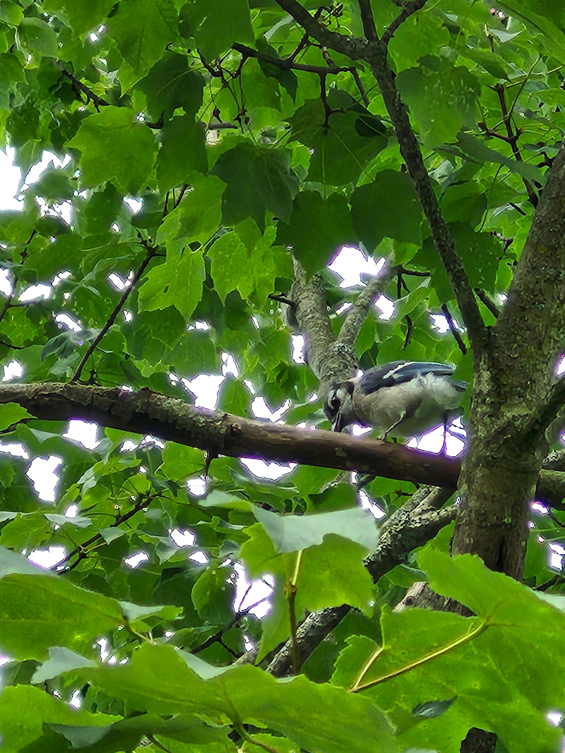
AGENDA
Introduction: Purpose of a Tree Inventory
Inventory Findings
Benefits Provided by Urban Trees

Slide 3
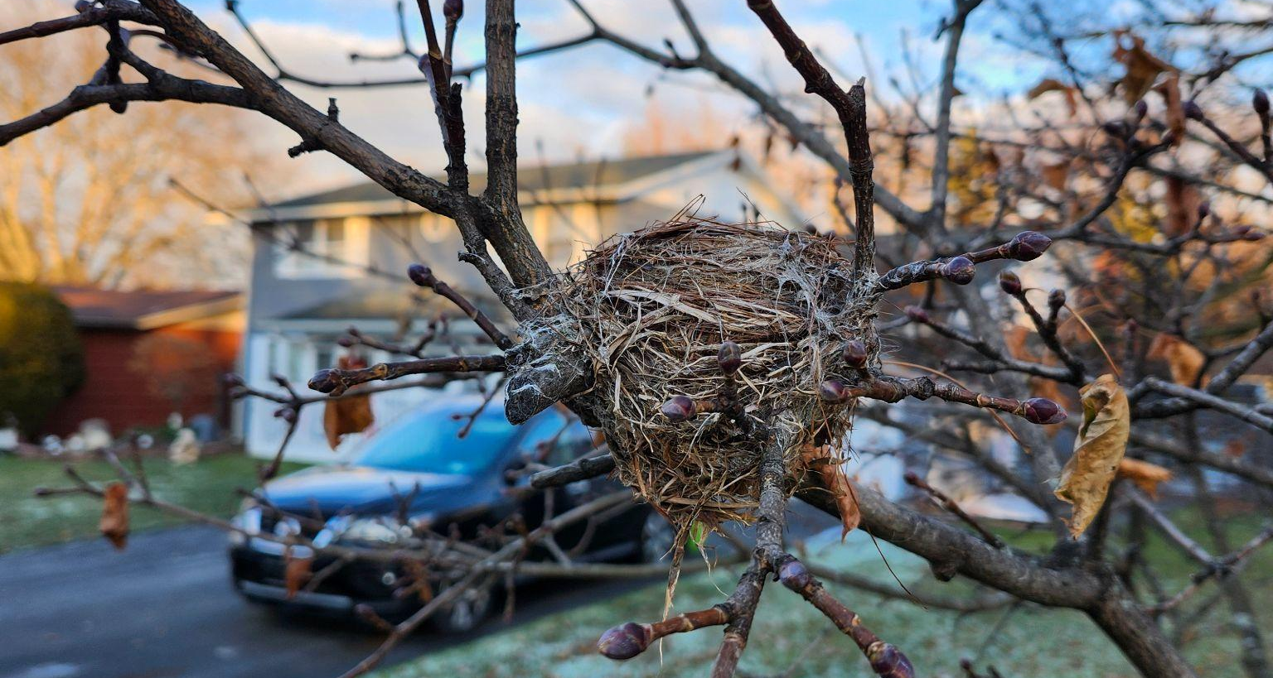
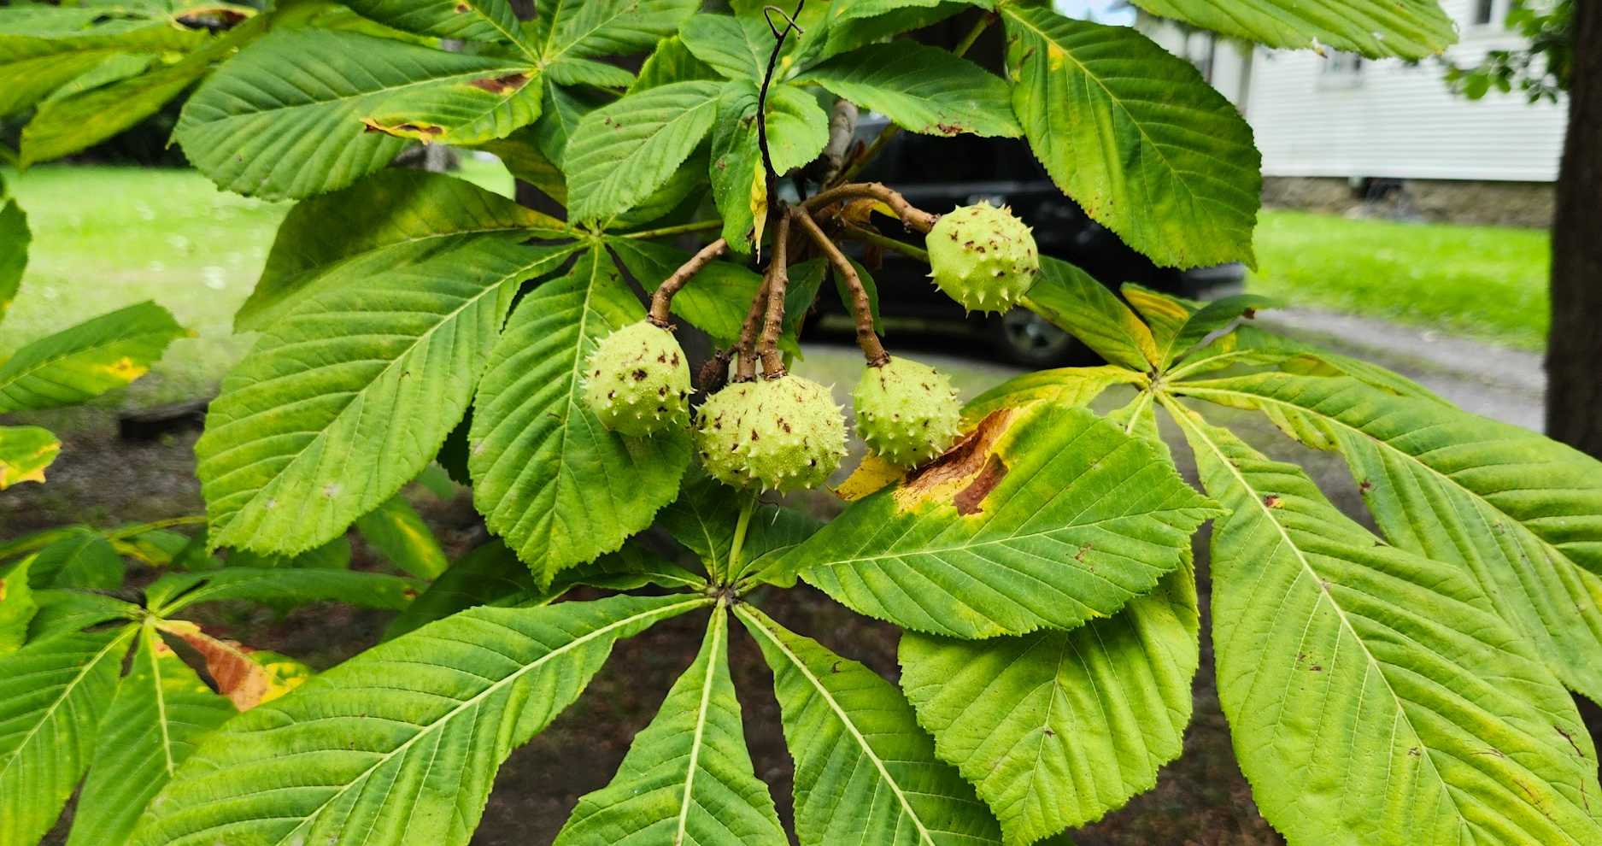
PURPOSE OF A TREE INVENTORY
Identify tree and planting site locations
Create database of publicly-owned trees
Mitigate risk associated with trees
Improve urban forest composition
Streamline operations
Estimate future needs

Slide 4
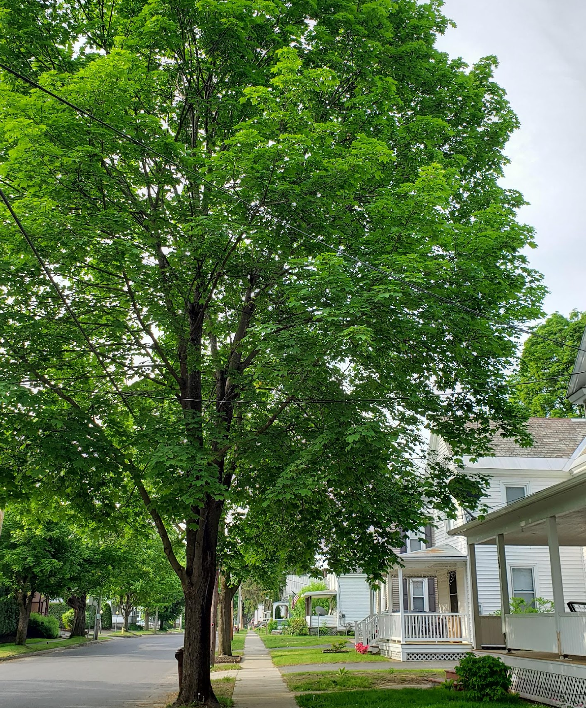
INVENTORY FINDINGS

Slide 5
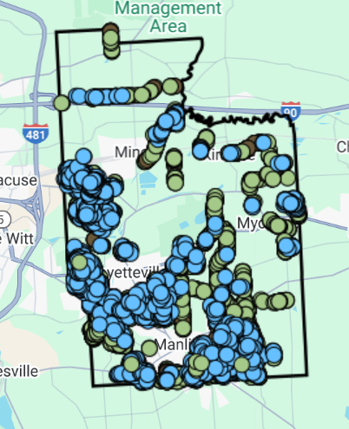
INVENTORY AREA
Public ROW
7,502 Sites
5826 Trees
259 Stumps
1,417 Vacant sites:
891 large vacant sites
71 medium vacant sites
455 small vacant sites

Slide 6
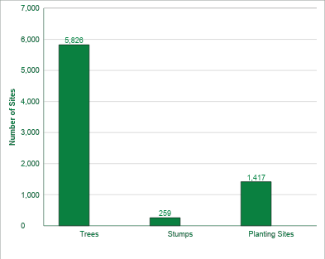
INVENTORY FINDINGS: SITE BREAKDOWN
Notes:
overall: Trees = 68% Planting Sites = 30% Stumps = 3%
Planting sites not collected in parks

Slide 7
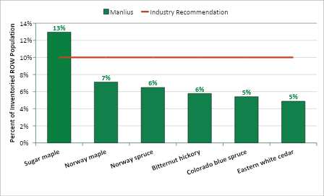
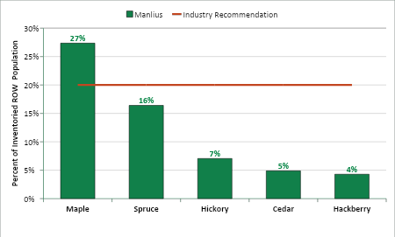
INVENTORY FINDINGS: SPECIES & GENUS
Species
Genus

Slide 8
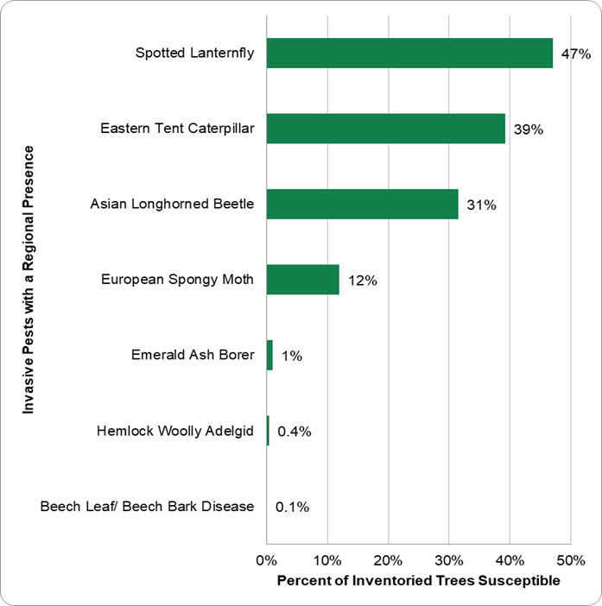
INVENTORY FINDINGS: PEST SUSCEPTIBILITY
Notes:
Does not mean these pests ARE or WILL BE in GF, just that certain percentage of tree population could host them

Slide 9
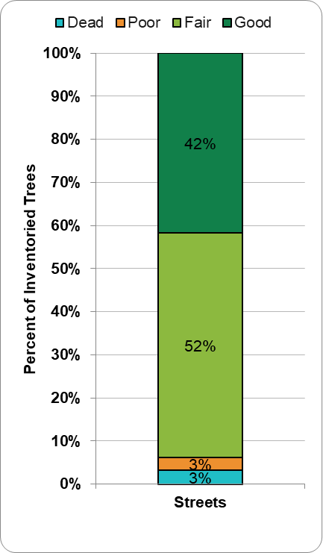
INVENTORY FINDINGS: CONDITION
Notes:
Fair = 55% Good+ = 33% Poor- = 10% Dead = 1%

Slide 10

BENEFITS PROVIDED BY PUBLIC TREES

Slide 11
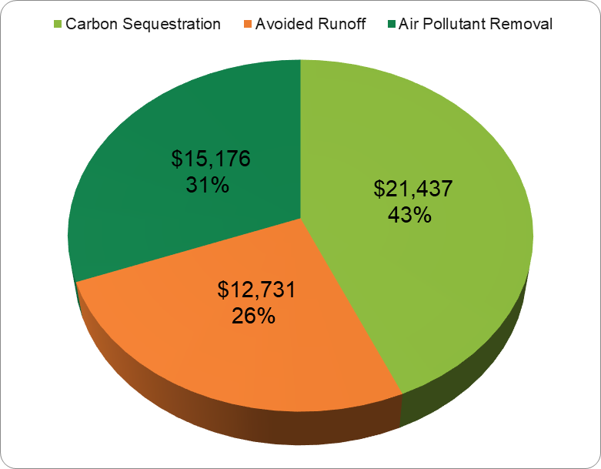
ANNUAL BENEFITS, QUANTIFIED
Notes:
Carbon = 80,420 pounds/year runoff = 1,007,378 gallons/year pollution = 2,780 pounds/year
Structural (replacement value) = $11,042,998

Slide 12
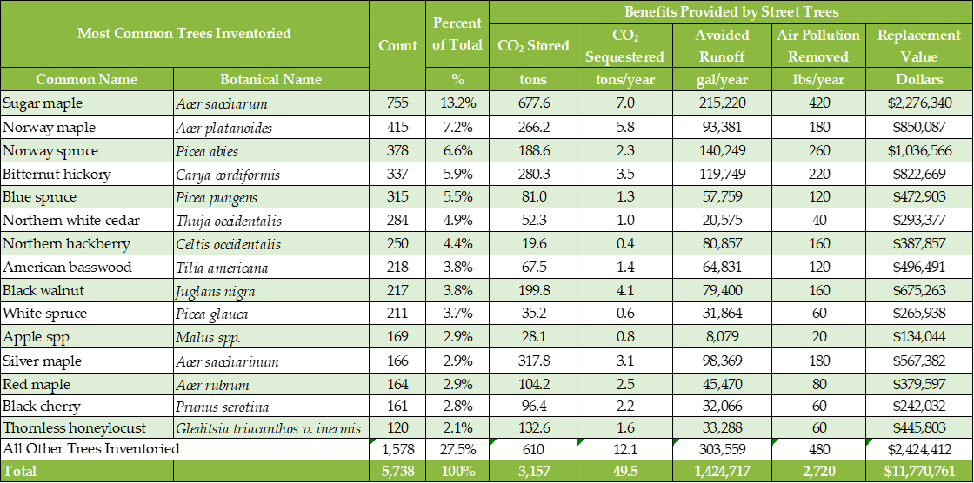
ANNUAL BENEFITS, QUANTIFIED
Notes:
Carbon = 80,420 pounds/year runoff = 1,007,378 gallons/year pollution = 2,780 pounds/year
Structural (replacement value) = $11,042,998

Slide 13
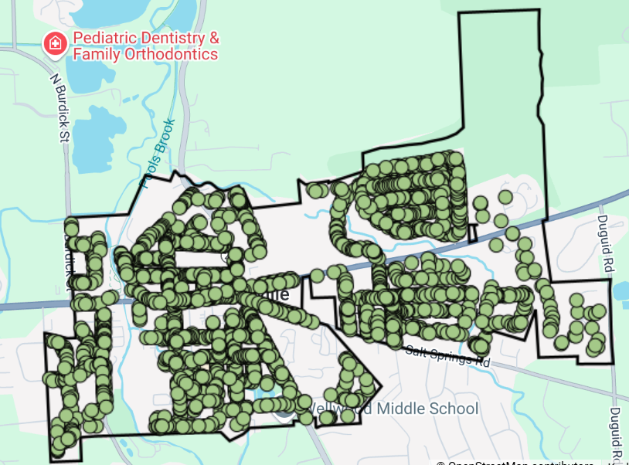
Village of Fayetteville

Slide 14
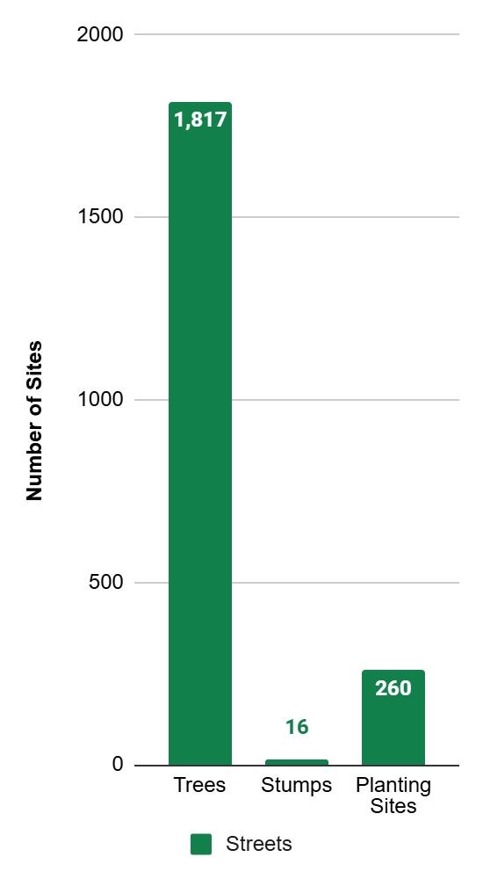


Slide 15
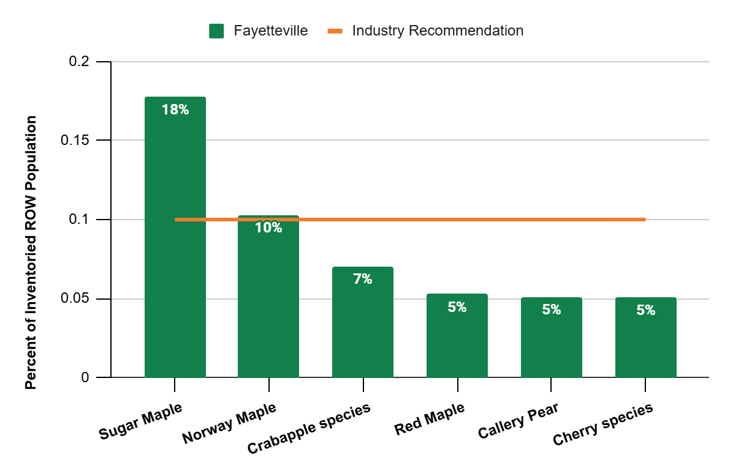

Slide 16
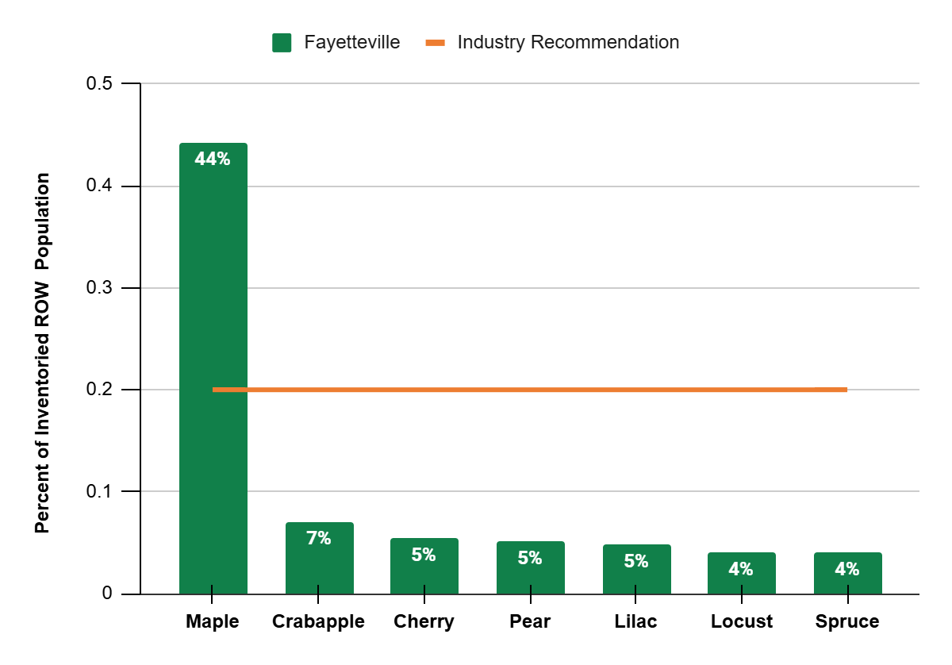

Slide 17
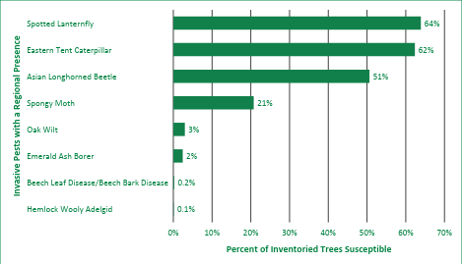

Slide 18
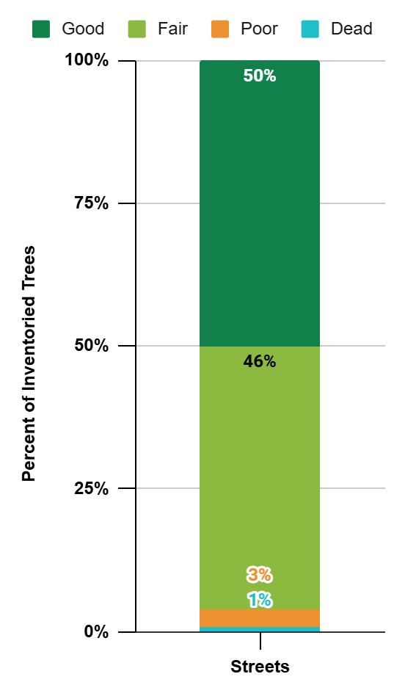

Slide 19
BENEFITS PROVIDED BY PUBLIC TREES

Slide 20
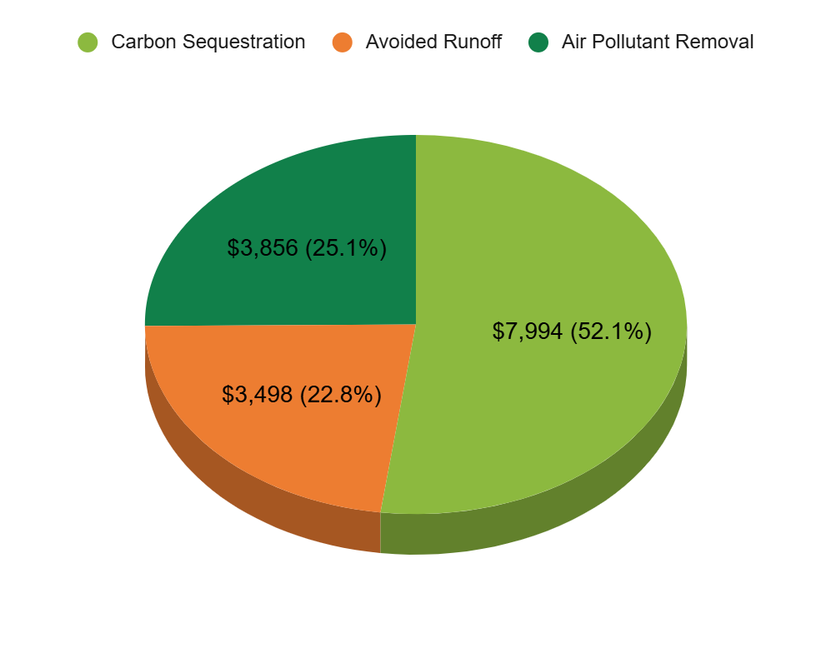

Slide 21
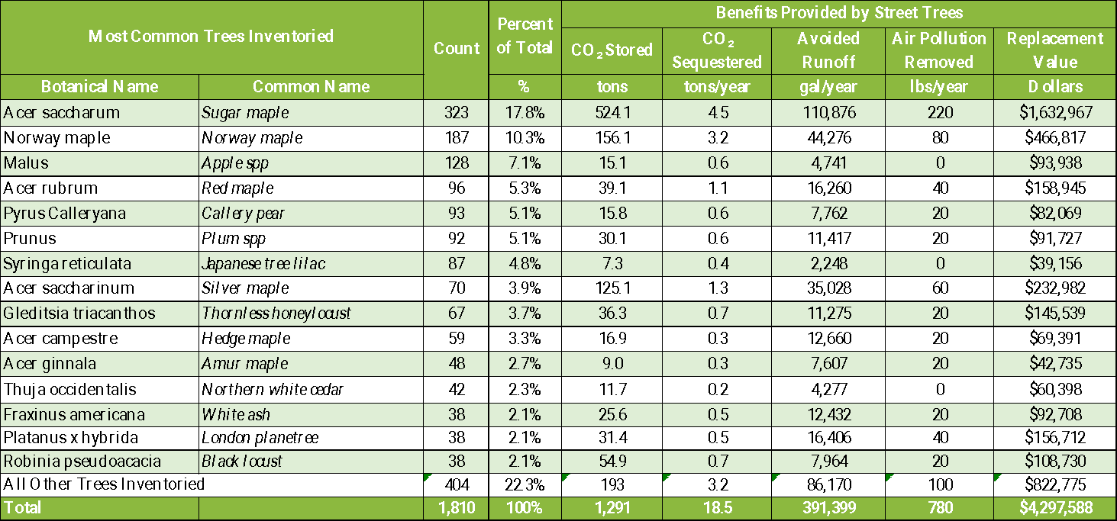

Slide 22
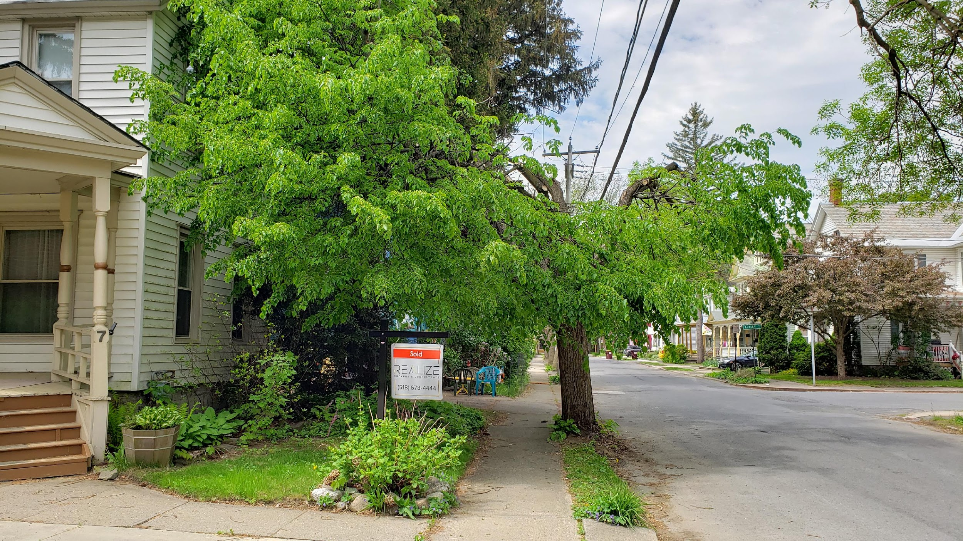
Benefits Provided by Urban Trees
Decrease heating/cooling costs
Stabilize soil & decrease runoff
Reduce air pollution
Increase property value
Reduce stress
…and many, many more!

Slide 23
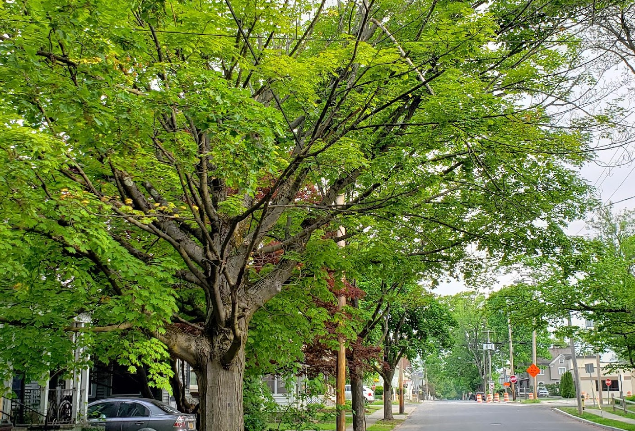
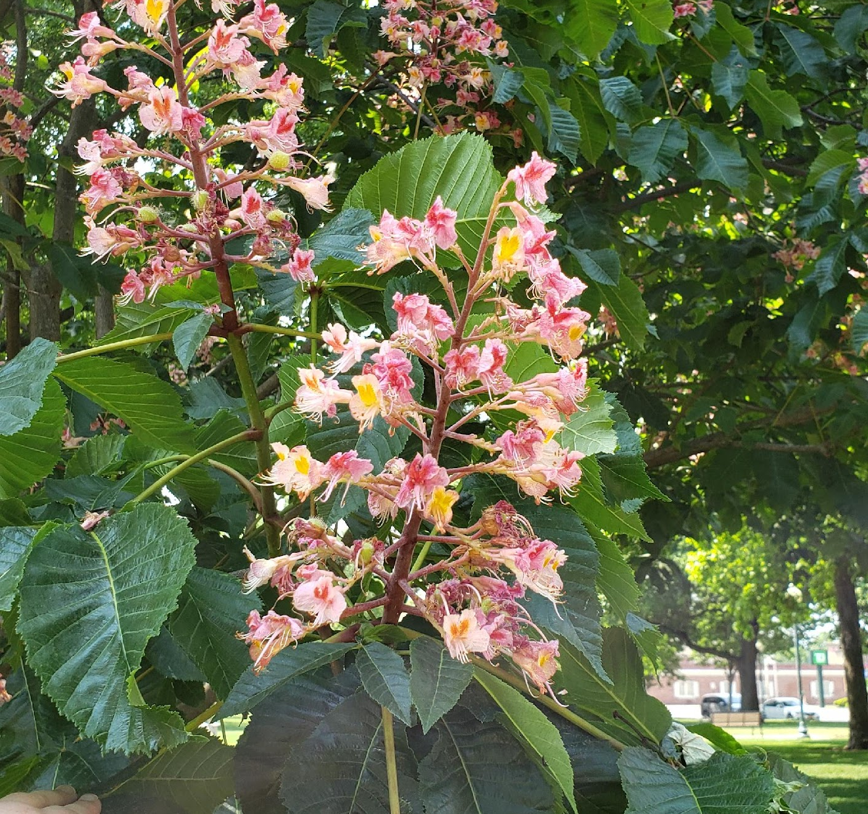


SUMMARY
A tree inventory is a:
Database
Maintenance tool
Management tool

Slide 24
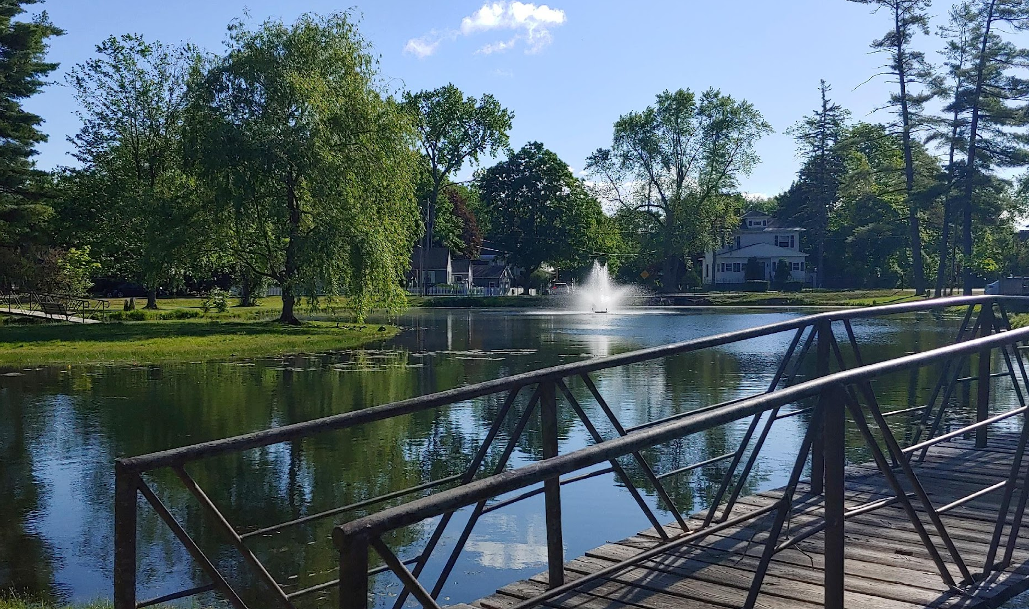

THANK YOU
Davey Resource Group | www.davey.com

