Slide 1
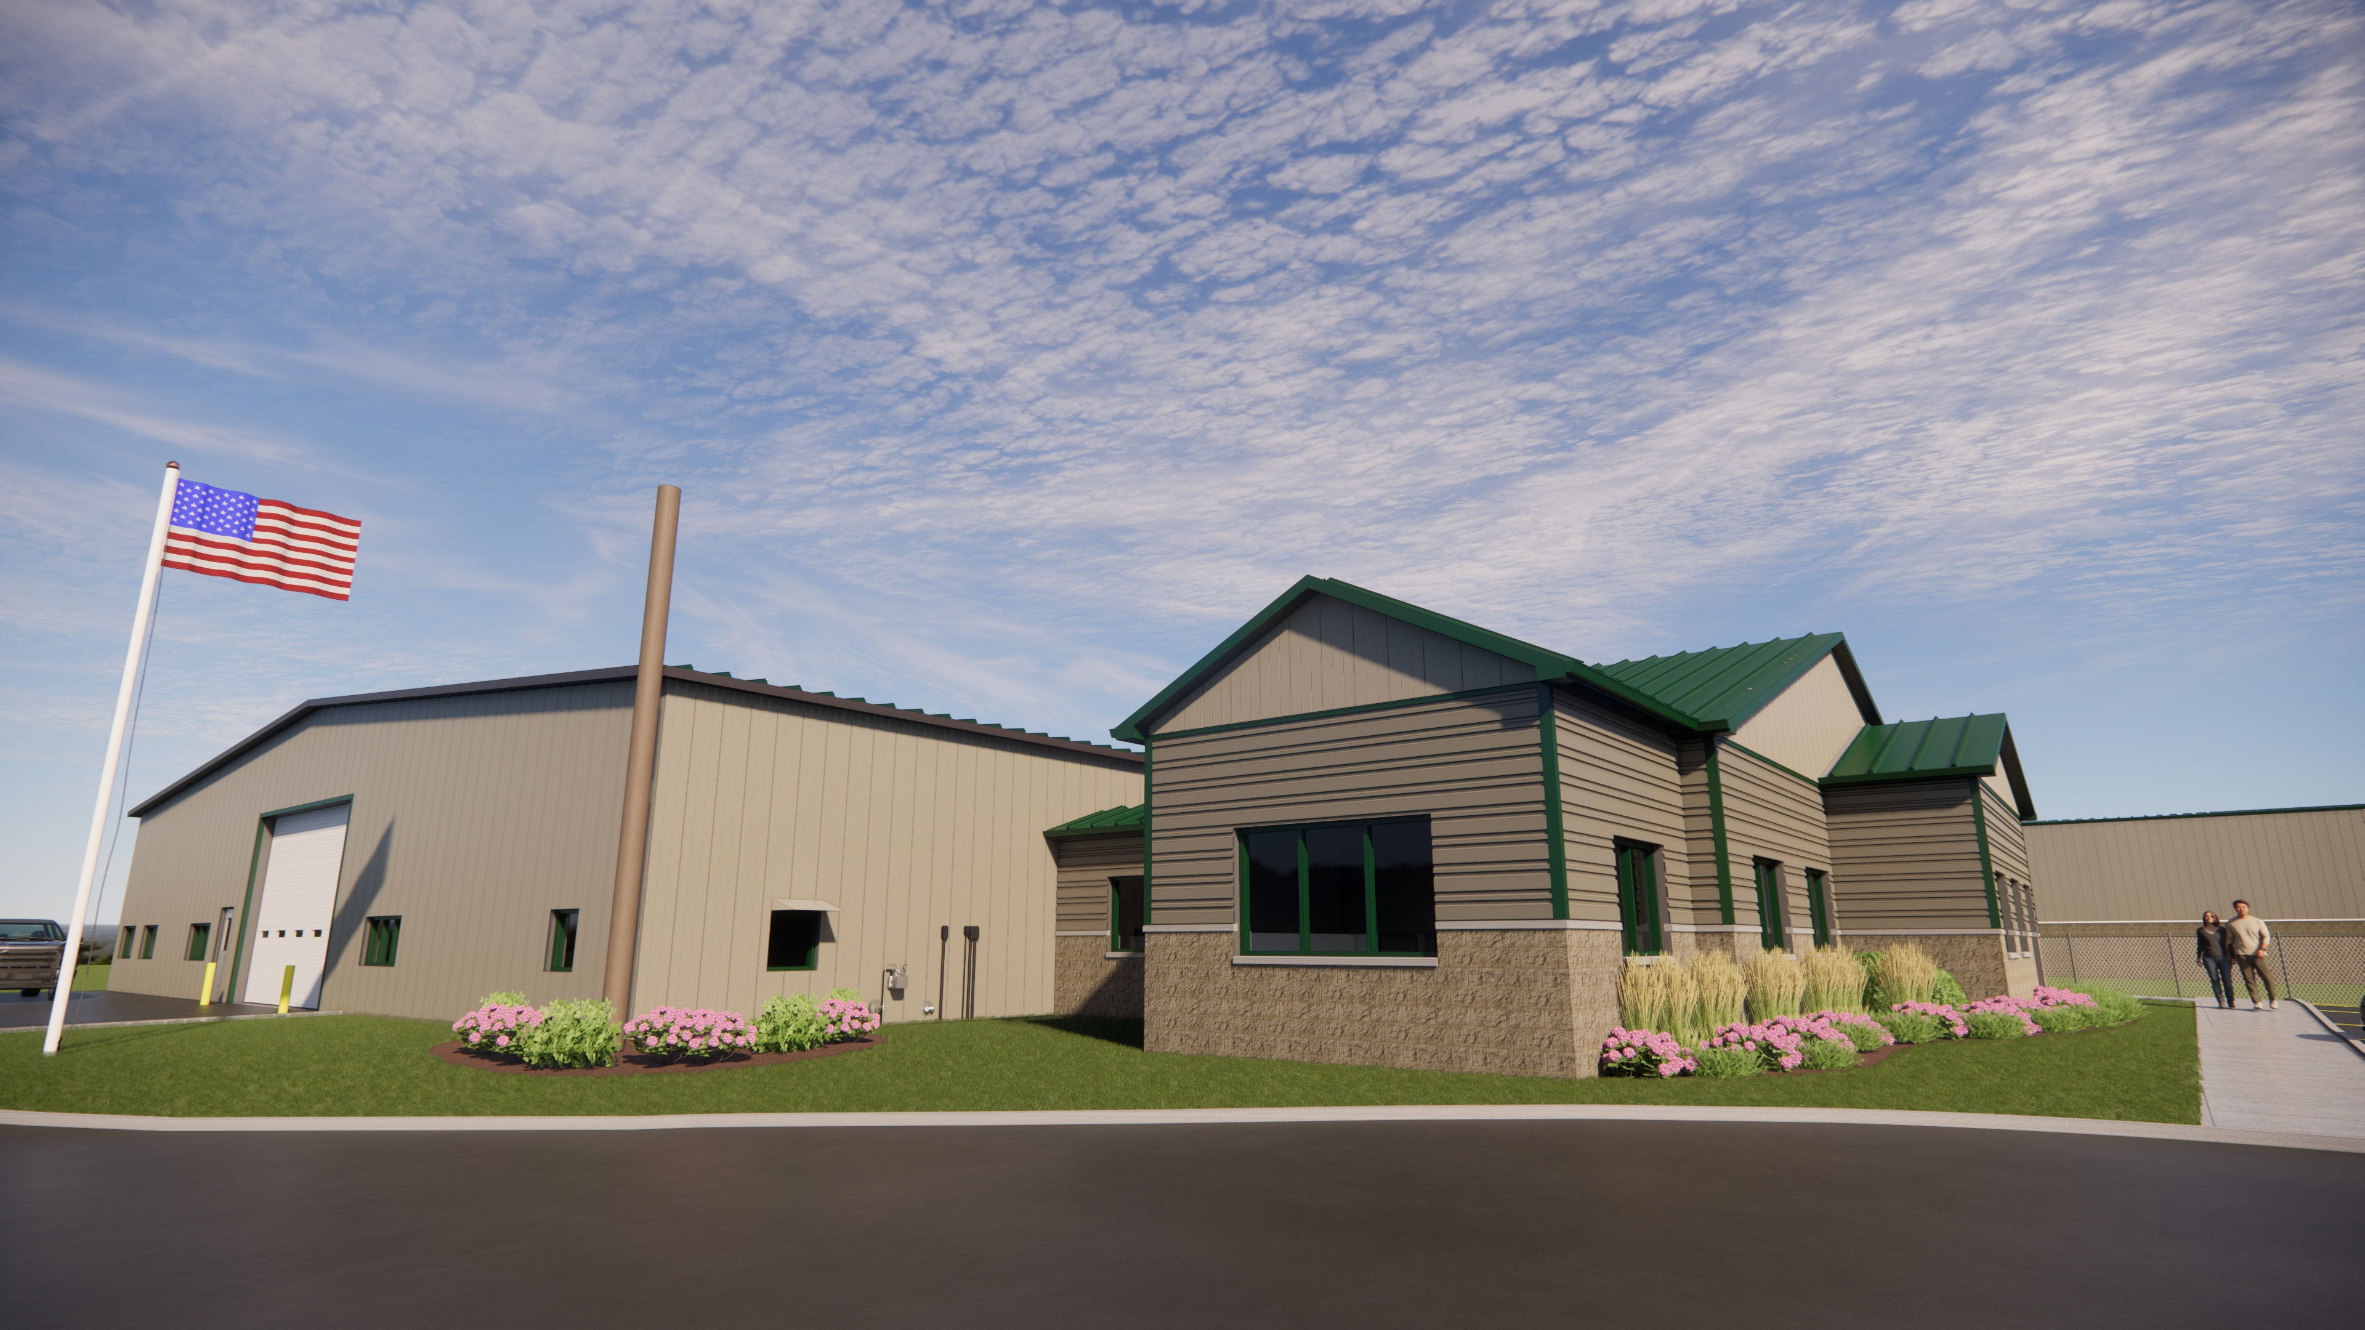
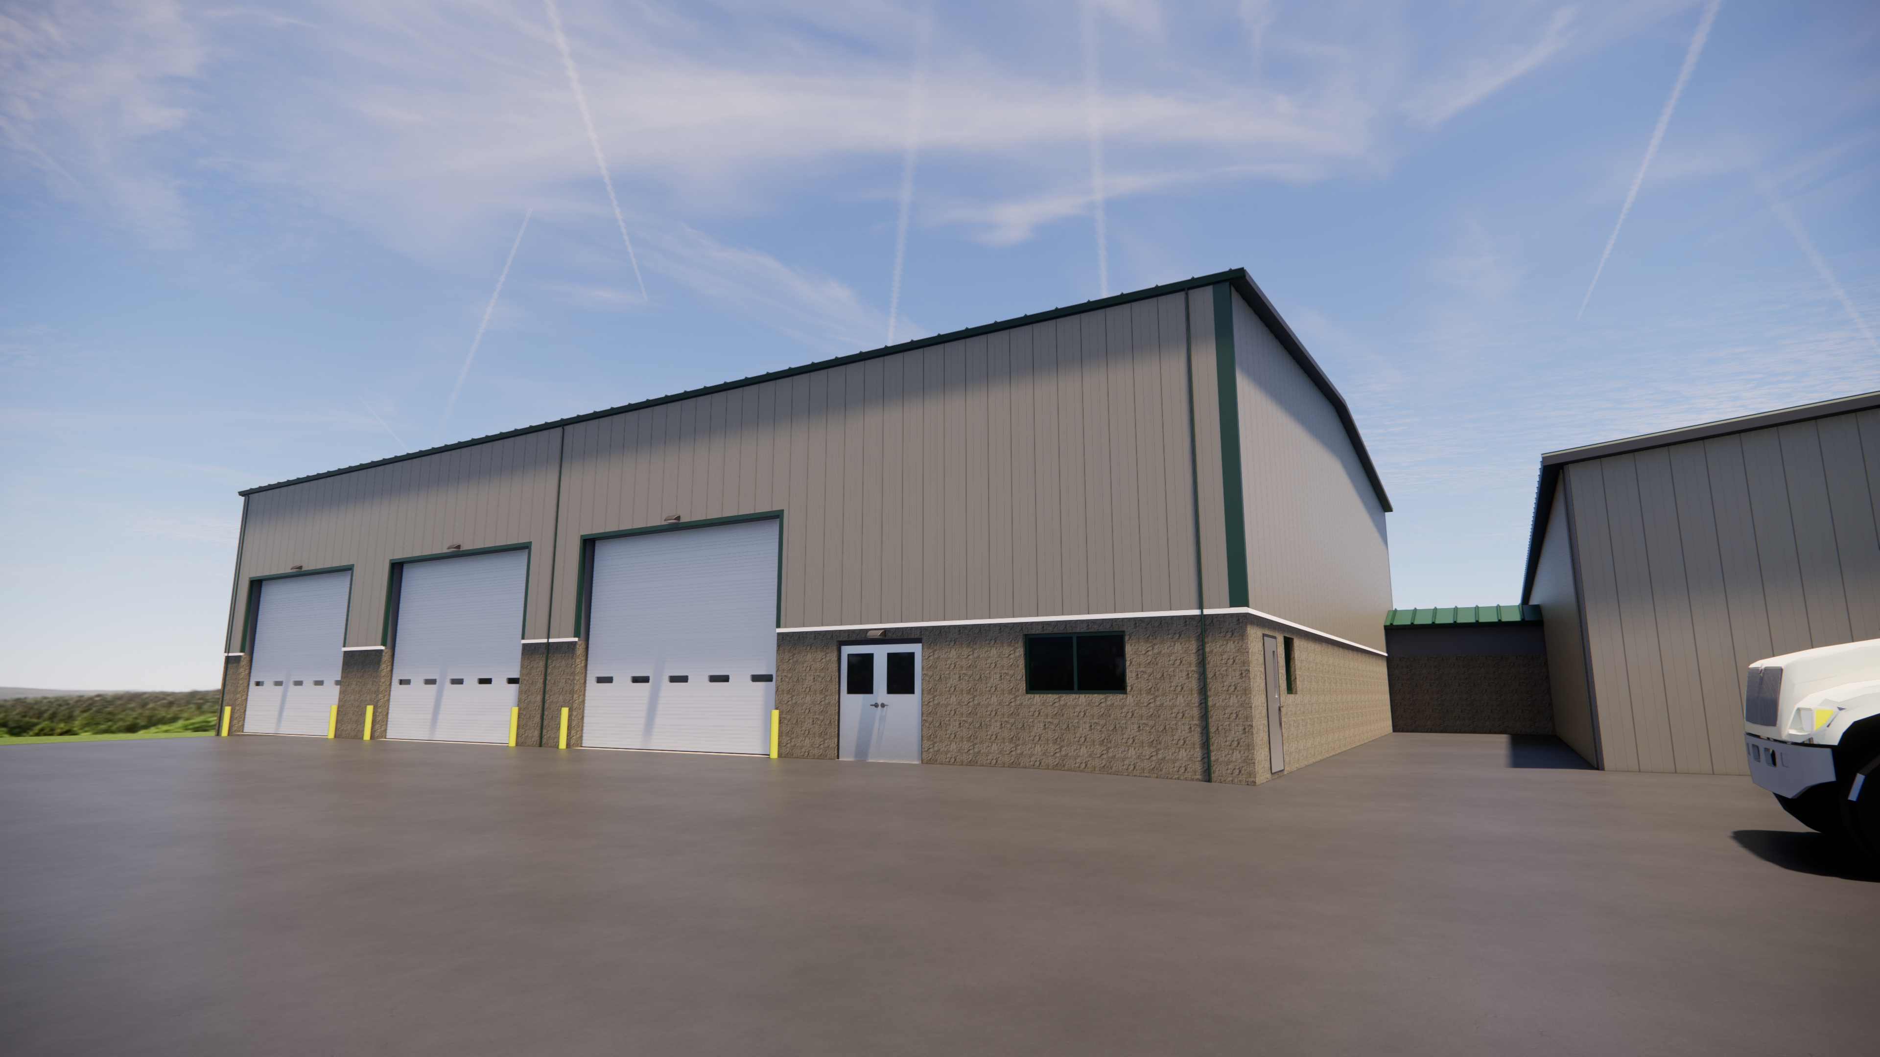

HIGHWAY FACILITIES ENHANCEMENT PROJECT
4-23-2025

Slide 2
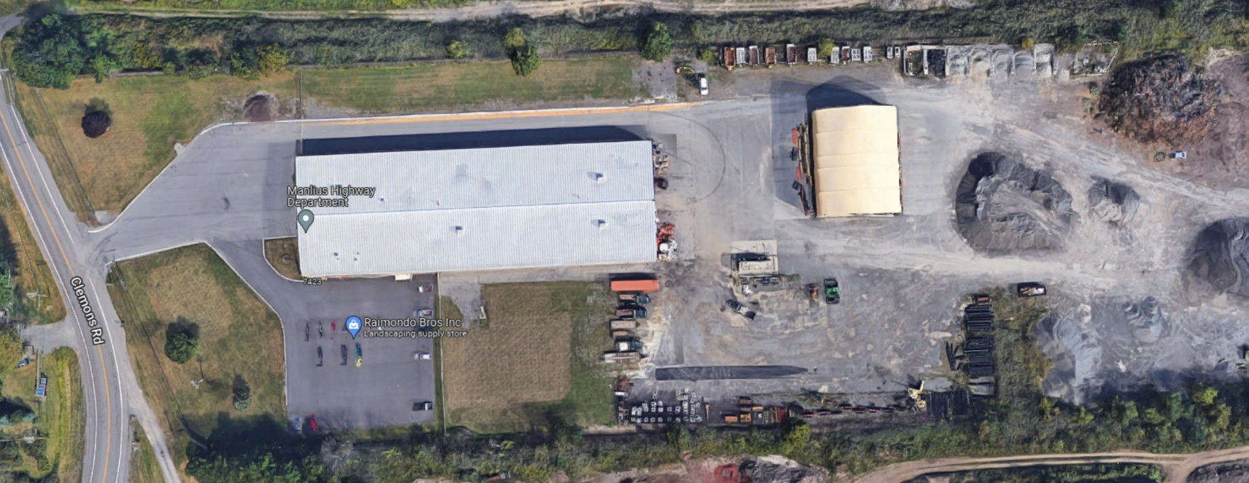
HIGHWAY FACILITIES ENHANCEMENT PROJECT
EXISTING HIGHWAY DEPARTMENT SITE
5970 CLEMONS ROAD, 12.38 ACRES, FIRST DEVELOPED IN 1985

Slide 3
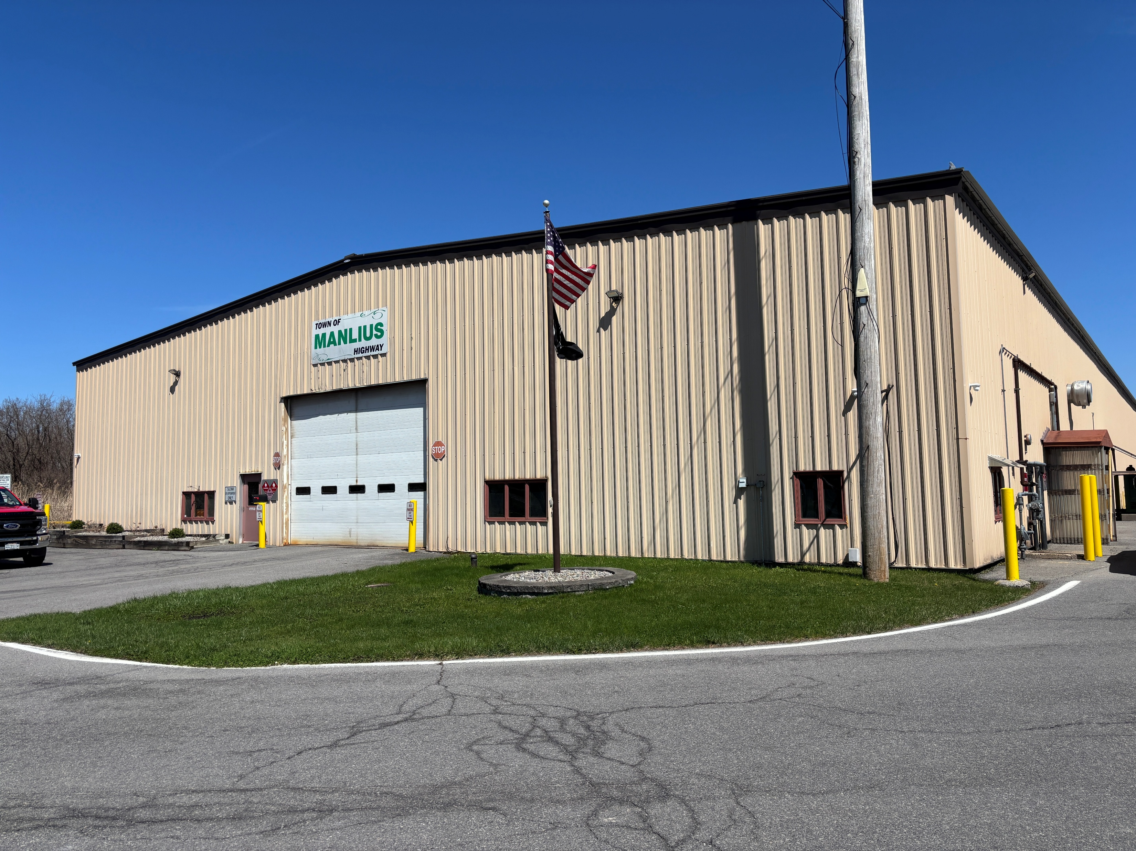
HIGHWAY FACILITIES ENHANCEMENT PROJECT
EXISTING HIGHWAY DEPARTMENT BUILDINGS
MAIN GARAGE
30,000 SF
CONSTRUCTED IN 1985
CONNECTED TO 2 LEACH FIELDS
PRE-ENGINEERED METAL BUILDING WITH 8’ HIGH CONCRETE BLOCK WALLS
BLOCK WALLS ARE FILLED WITH VERMICULITE, WHICH CONTAINS ASBESTOS. THEREFORE, NEW AND EXISTING MASONRY OPENINGS REQUIRE ABATEMENT

Slide 4
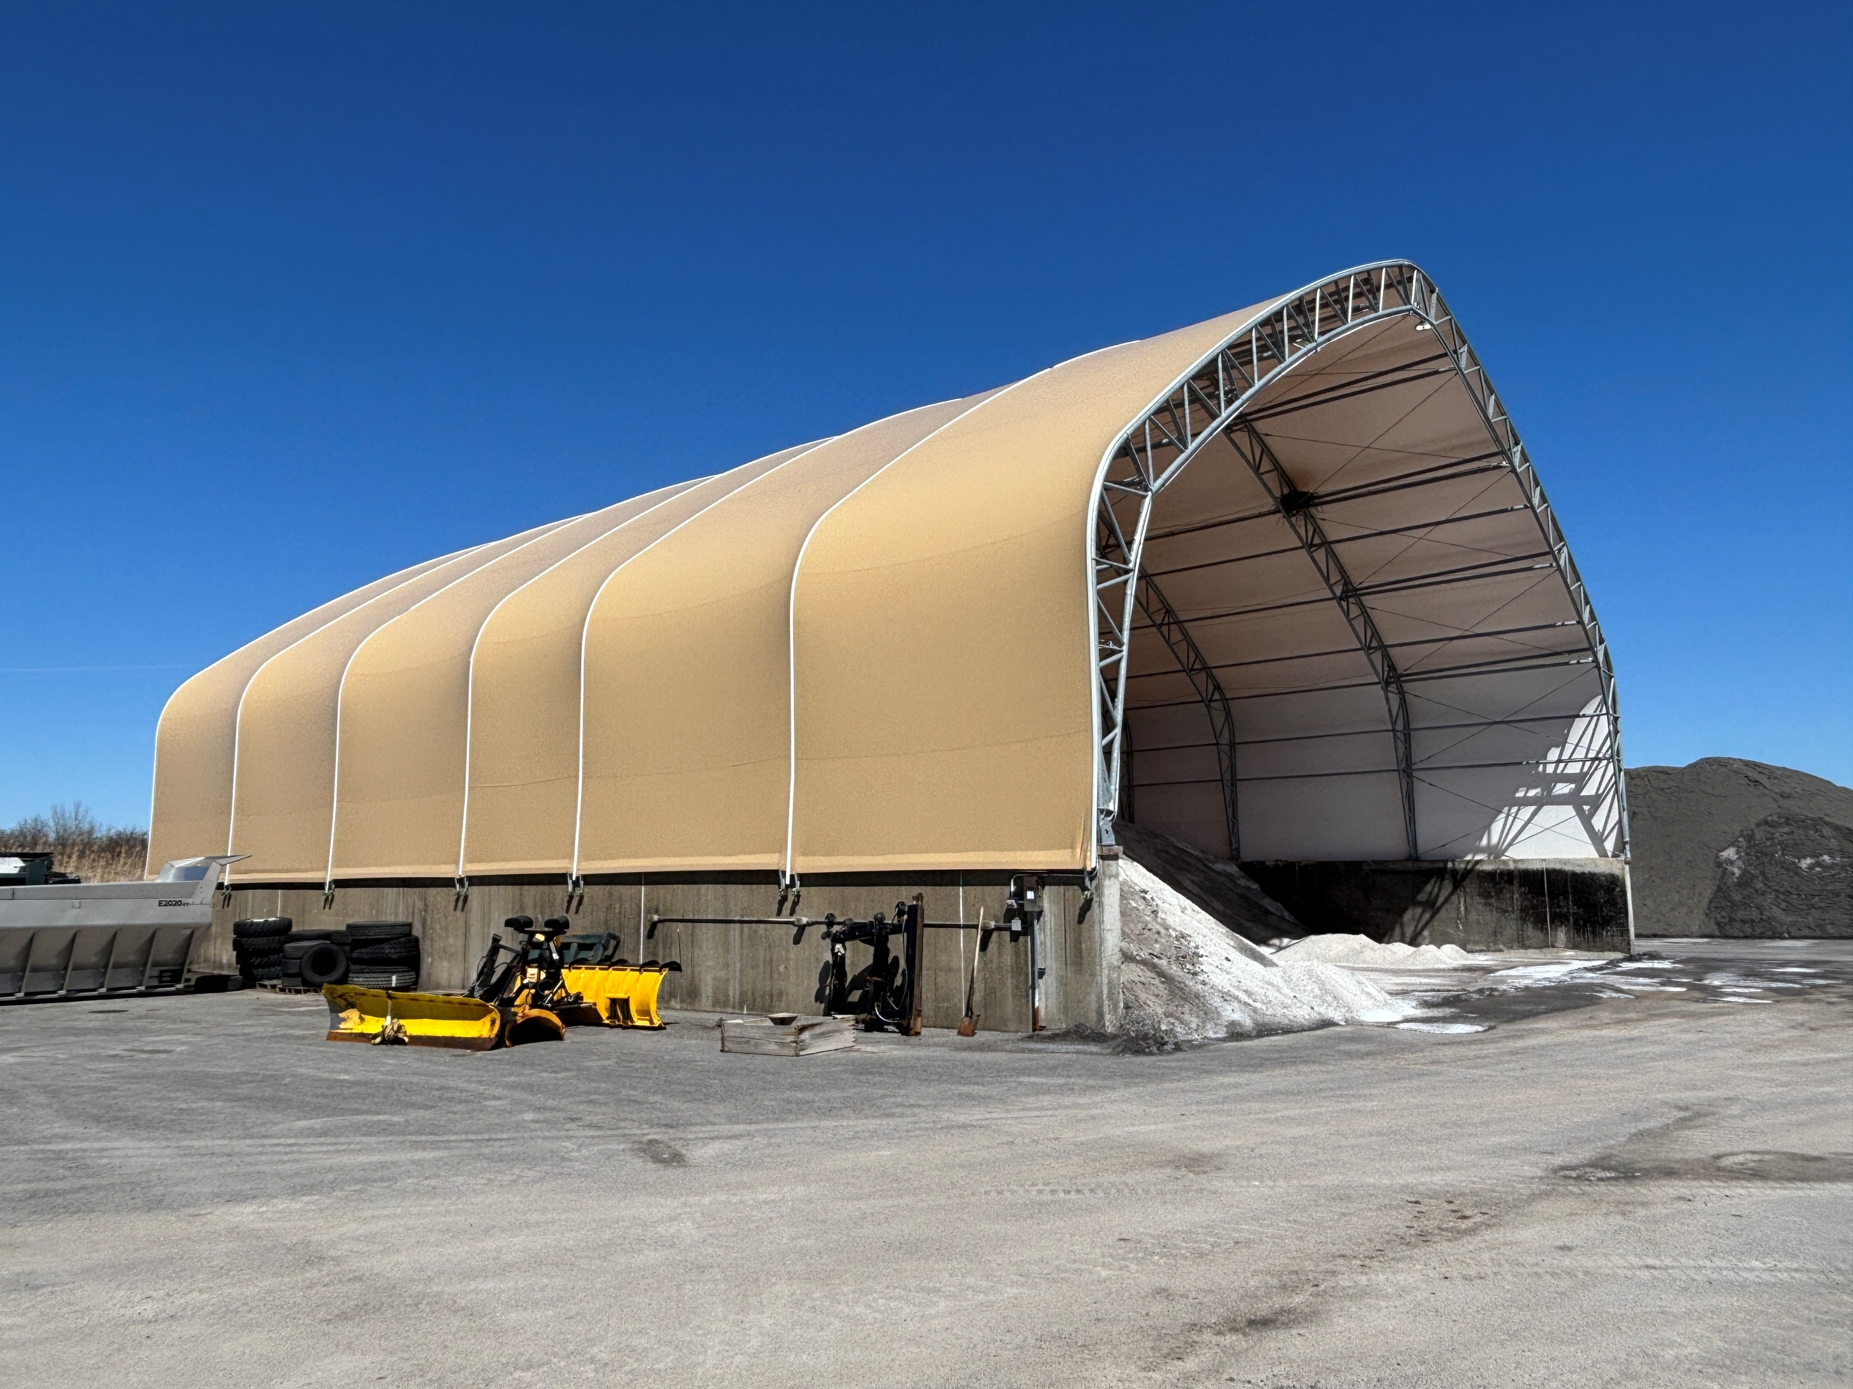
HIGHWAY FACILITIES ENHANCEMENT PROJECT
EXISTING HIGHWAY DEPT BUILDINGS
SALT STORAGE SHED
6,300 SF
CONSTRUCTED IN 2008
ROOF REPLACED 2022

Slide 5
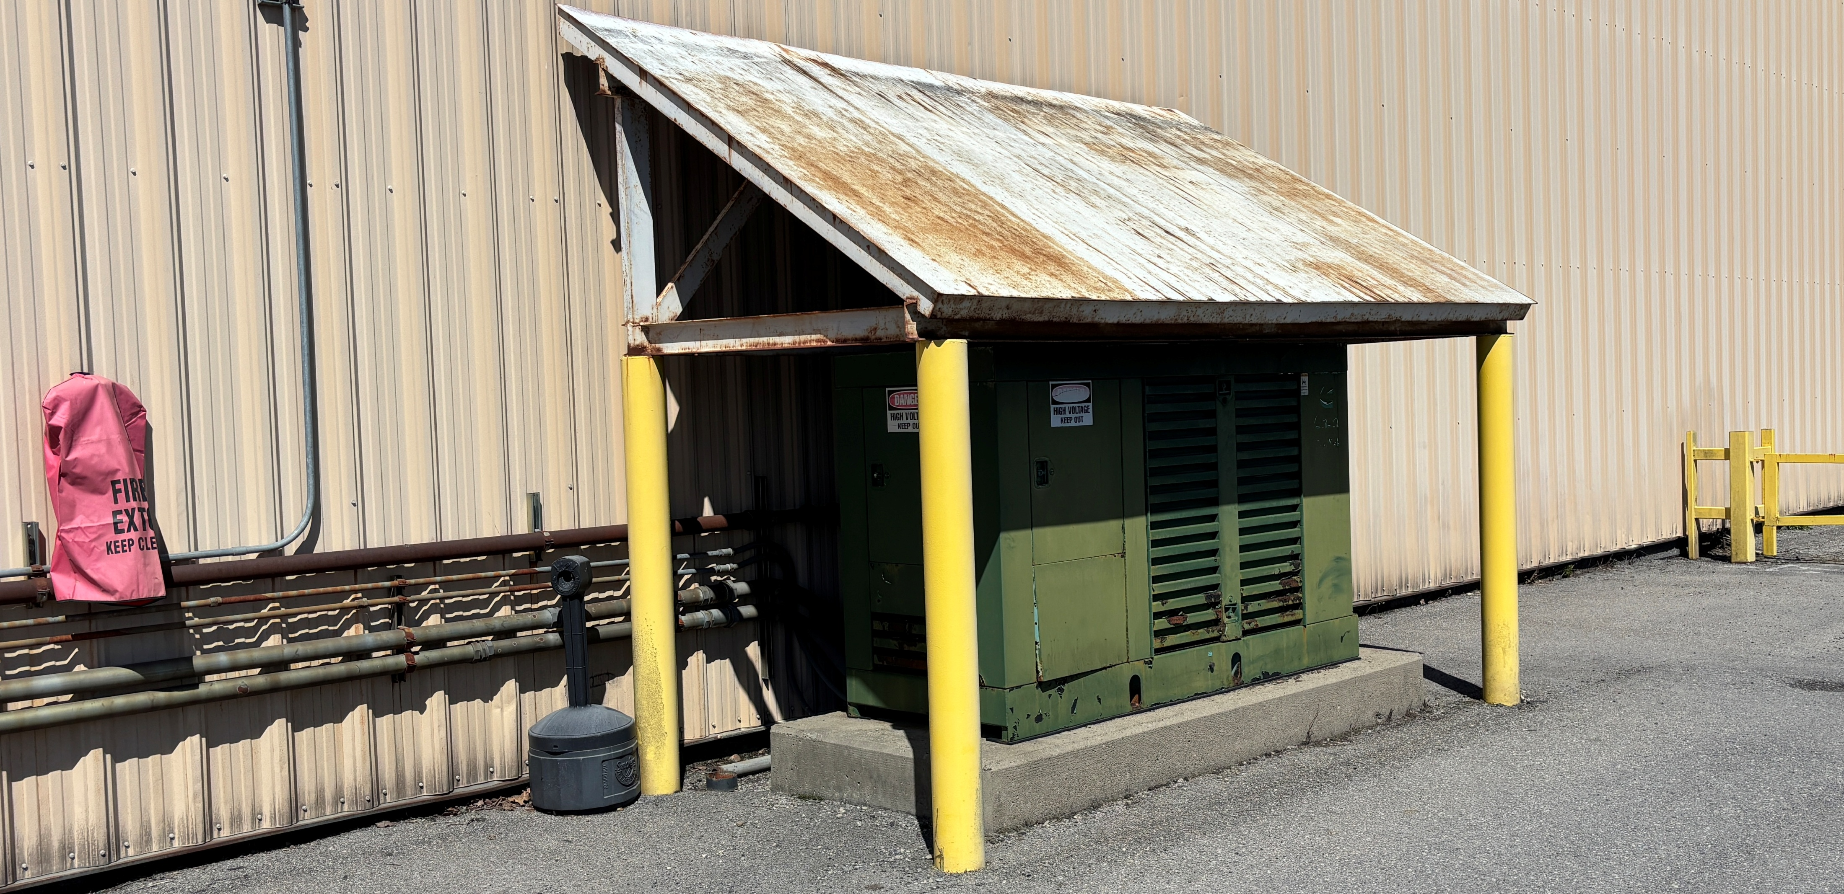
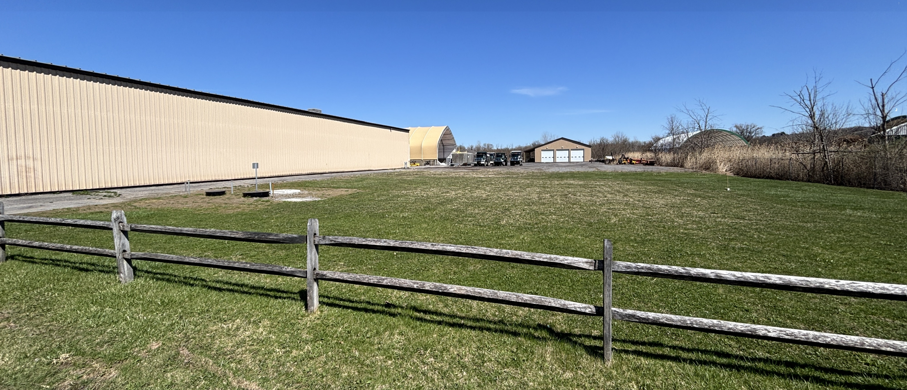
HIGHWAY FACILITIES ENHANCEMENT PROJECT
OTHER EXISTING FACILITIES
EMERGENCY GENERATOR
INSTALLED IN 1998
NEEDS REPLACEMENT
OIL-WATER SEPARATOR
OLD ONE REMOVED AND REPLACED IN 2023
CONNECTION PROVIDED FOR MAINTENANCE ADDITION

Slide 6
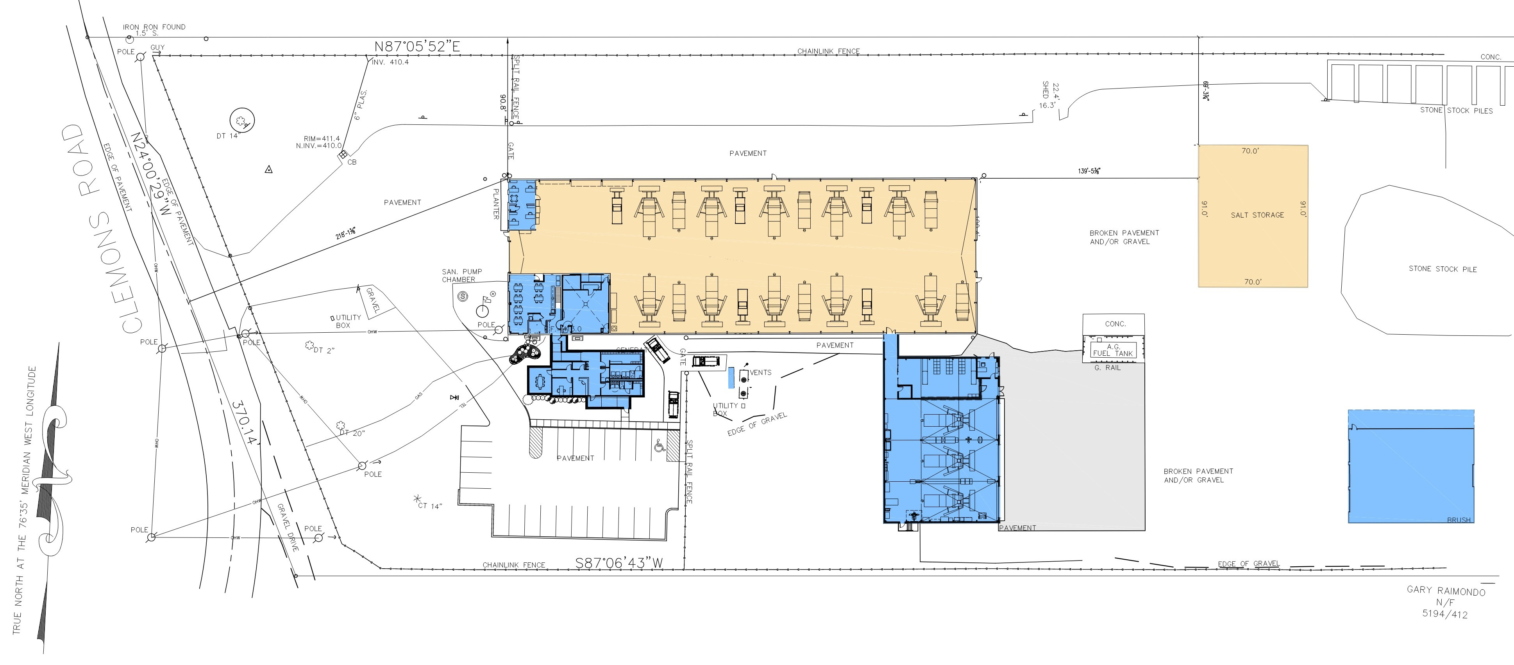
HIGHWAY FACILITIES ENHANCEMENT PROJECT
PROPOSED SITE PLAN
FOREMEN OFFICES
MAIN GARAGE
SALT STORAGE SHED
BREAK ROOM &
TRAINING ROOM
LEACH FIELD
VEHICLE STORAGE BUILDING
OFFICE/LOCKER
ROOM ADDITION
NEW
GENERATOR
LEACH
FIELD
MAINTENANCE ADDITION

Slide 7
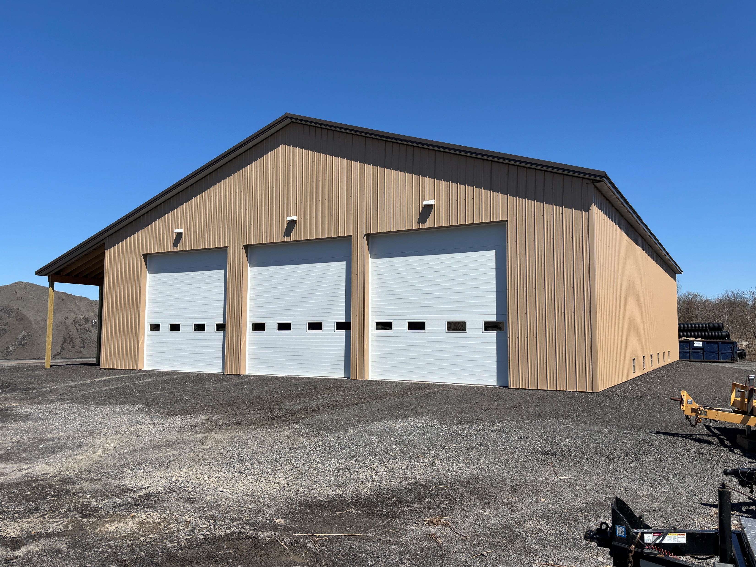
HIGHWAY FACILITIES ENHANCEMENT PROJECT
NEW HIGHWAY DEPT BUILDINGS
VEHICLE STORAGE BLDG
4,800 SF
CONSTRUCTED IN 2024
SIMPLE, 3-BAY POLE BARN
PROTECTS VEHICLES & EQUIPMENT FORMERLY LEFT OUTSIDE
HAS ELECTRICITY FOR LIGHTING
AND POWER BUT NO HEAT
INCLUDES 640 SF OF COVERED OUTDOOR STORAGE

Slide 8
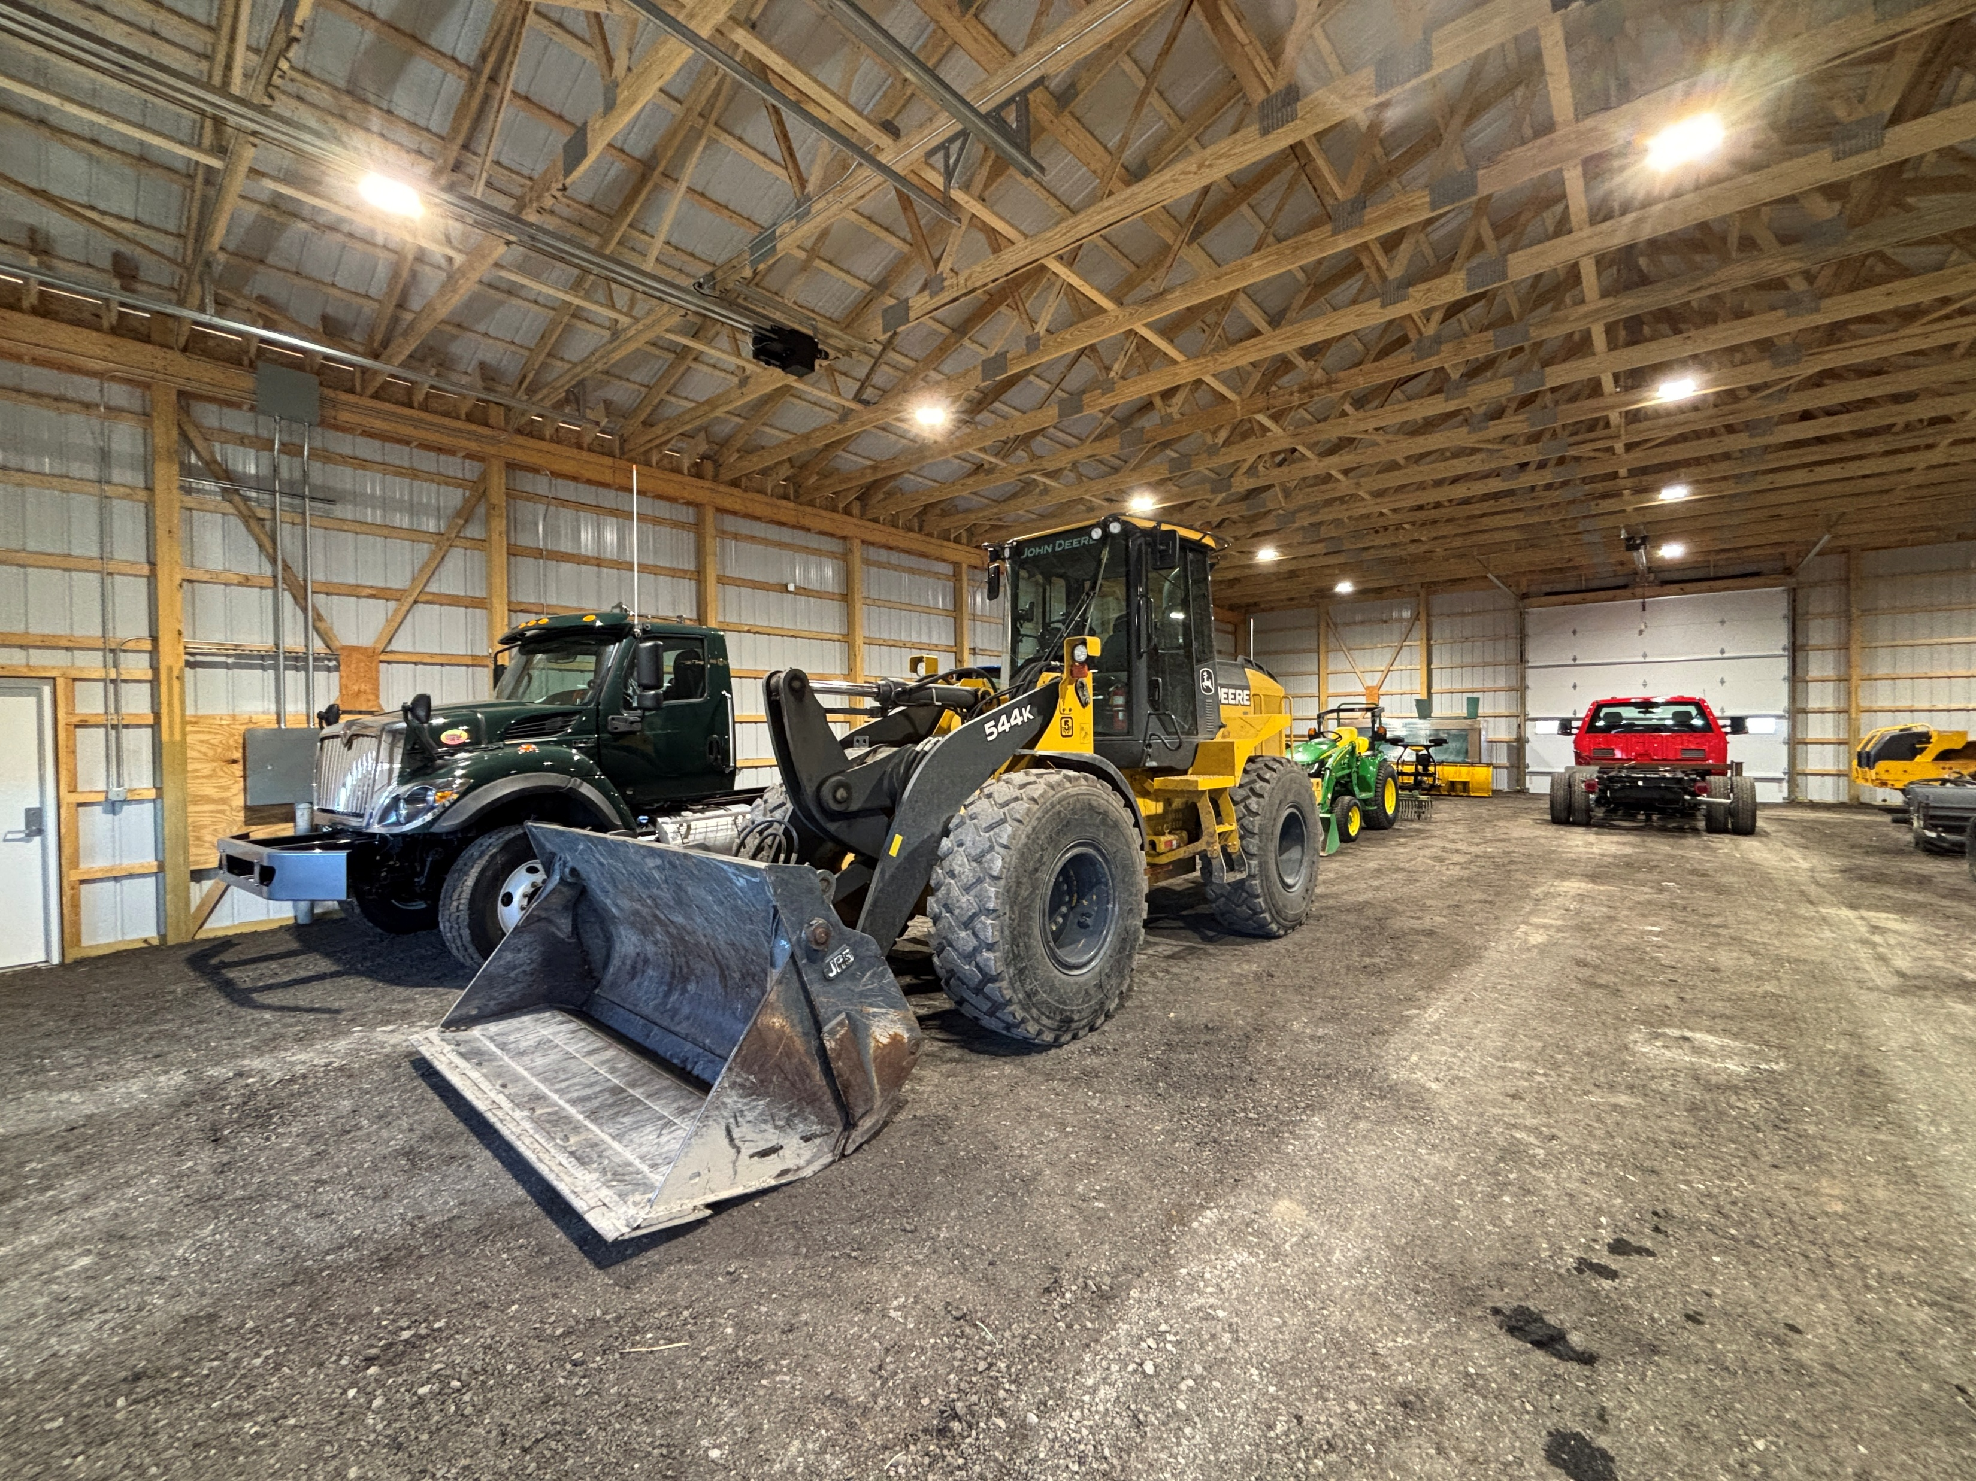
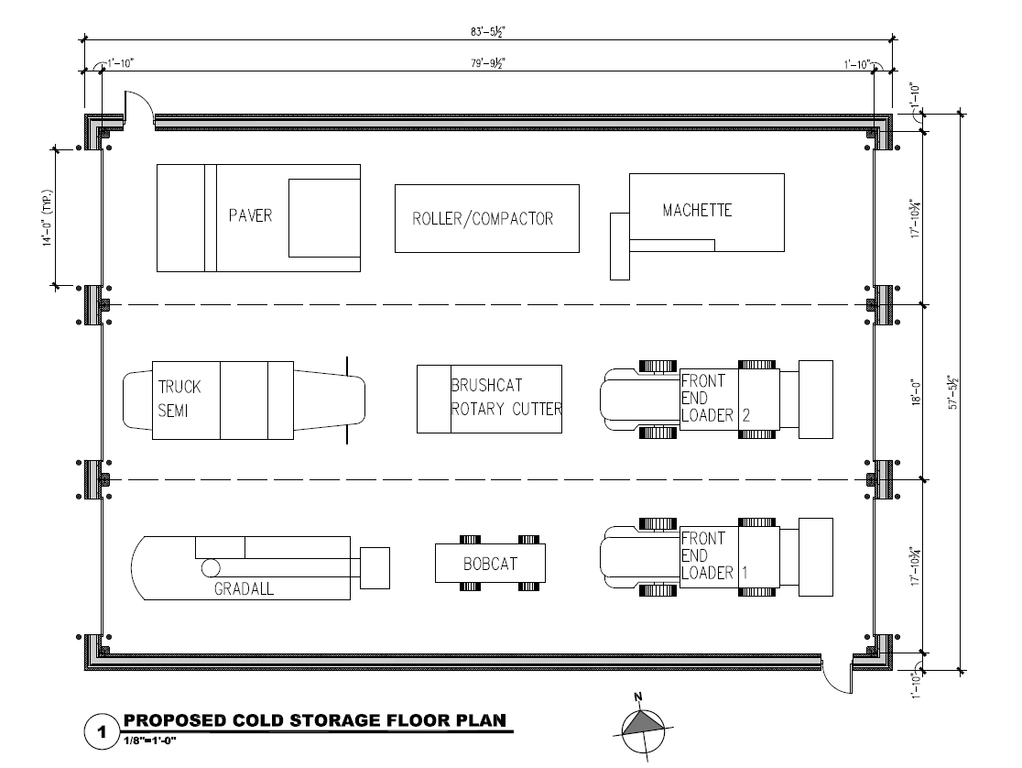
HIGHWAY FACILITIES ENHANCEMENT PROJECT
NEW HIGHWAY DEPT BUILDINGS
VEHICLE STORAGE BLDG

Slide 9
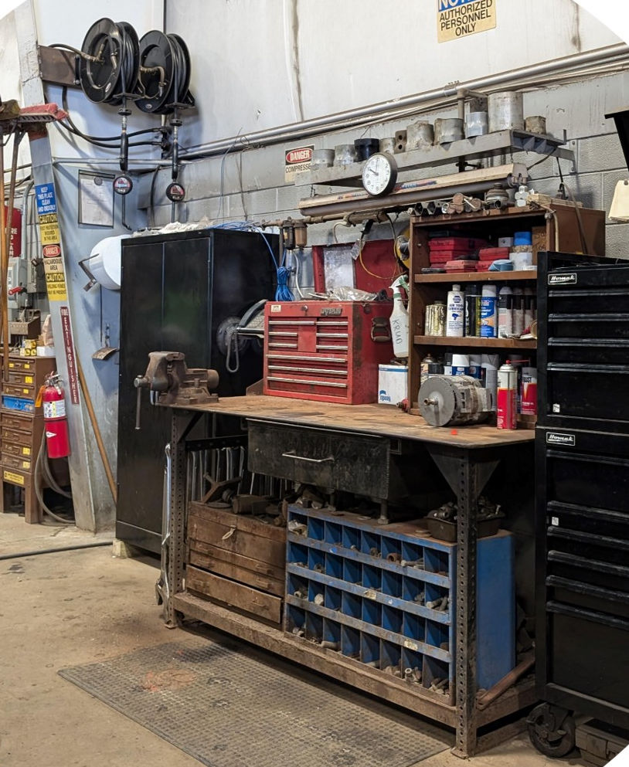
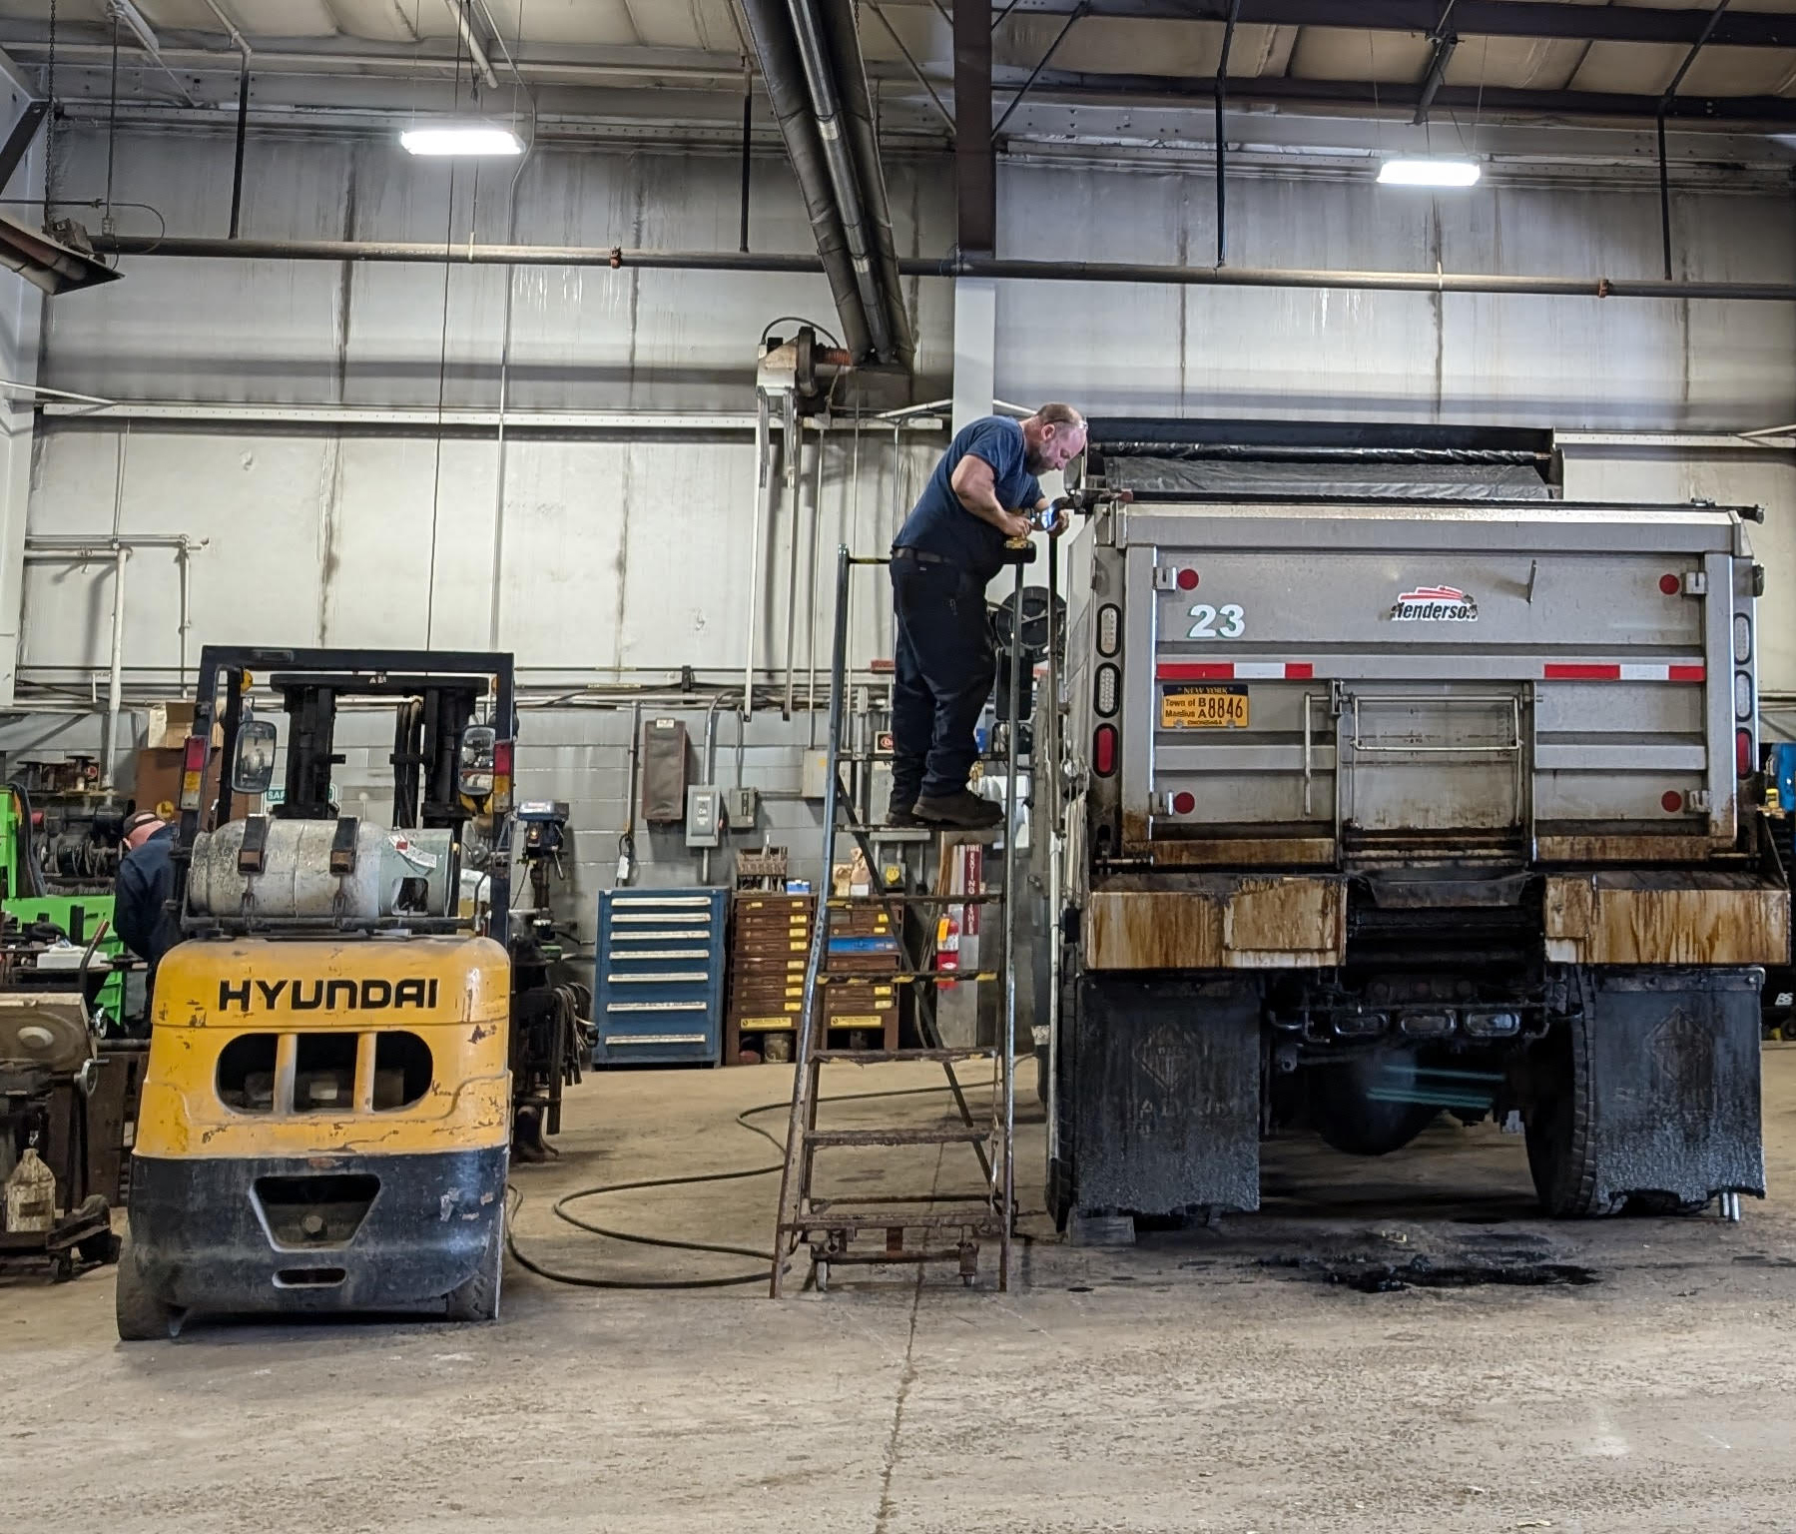
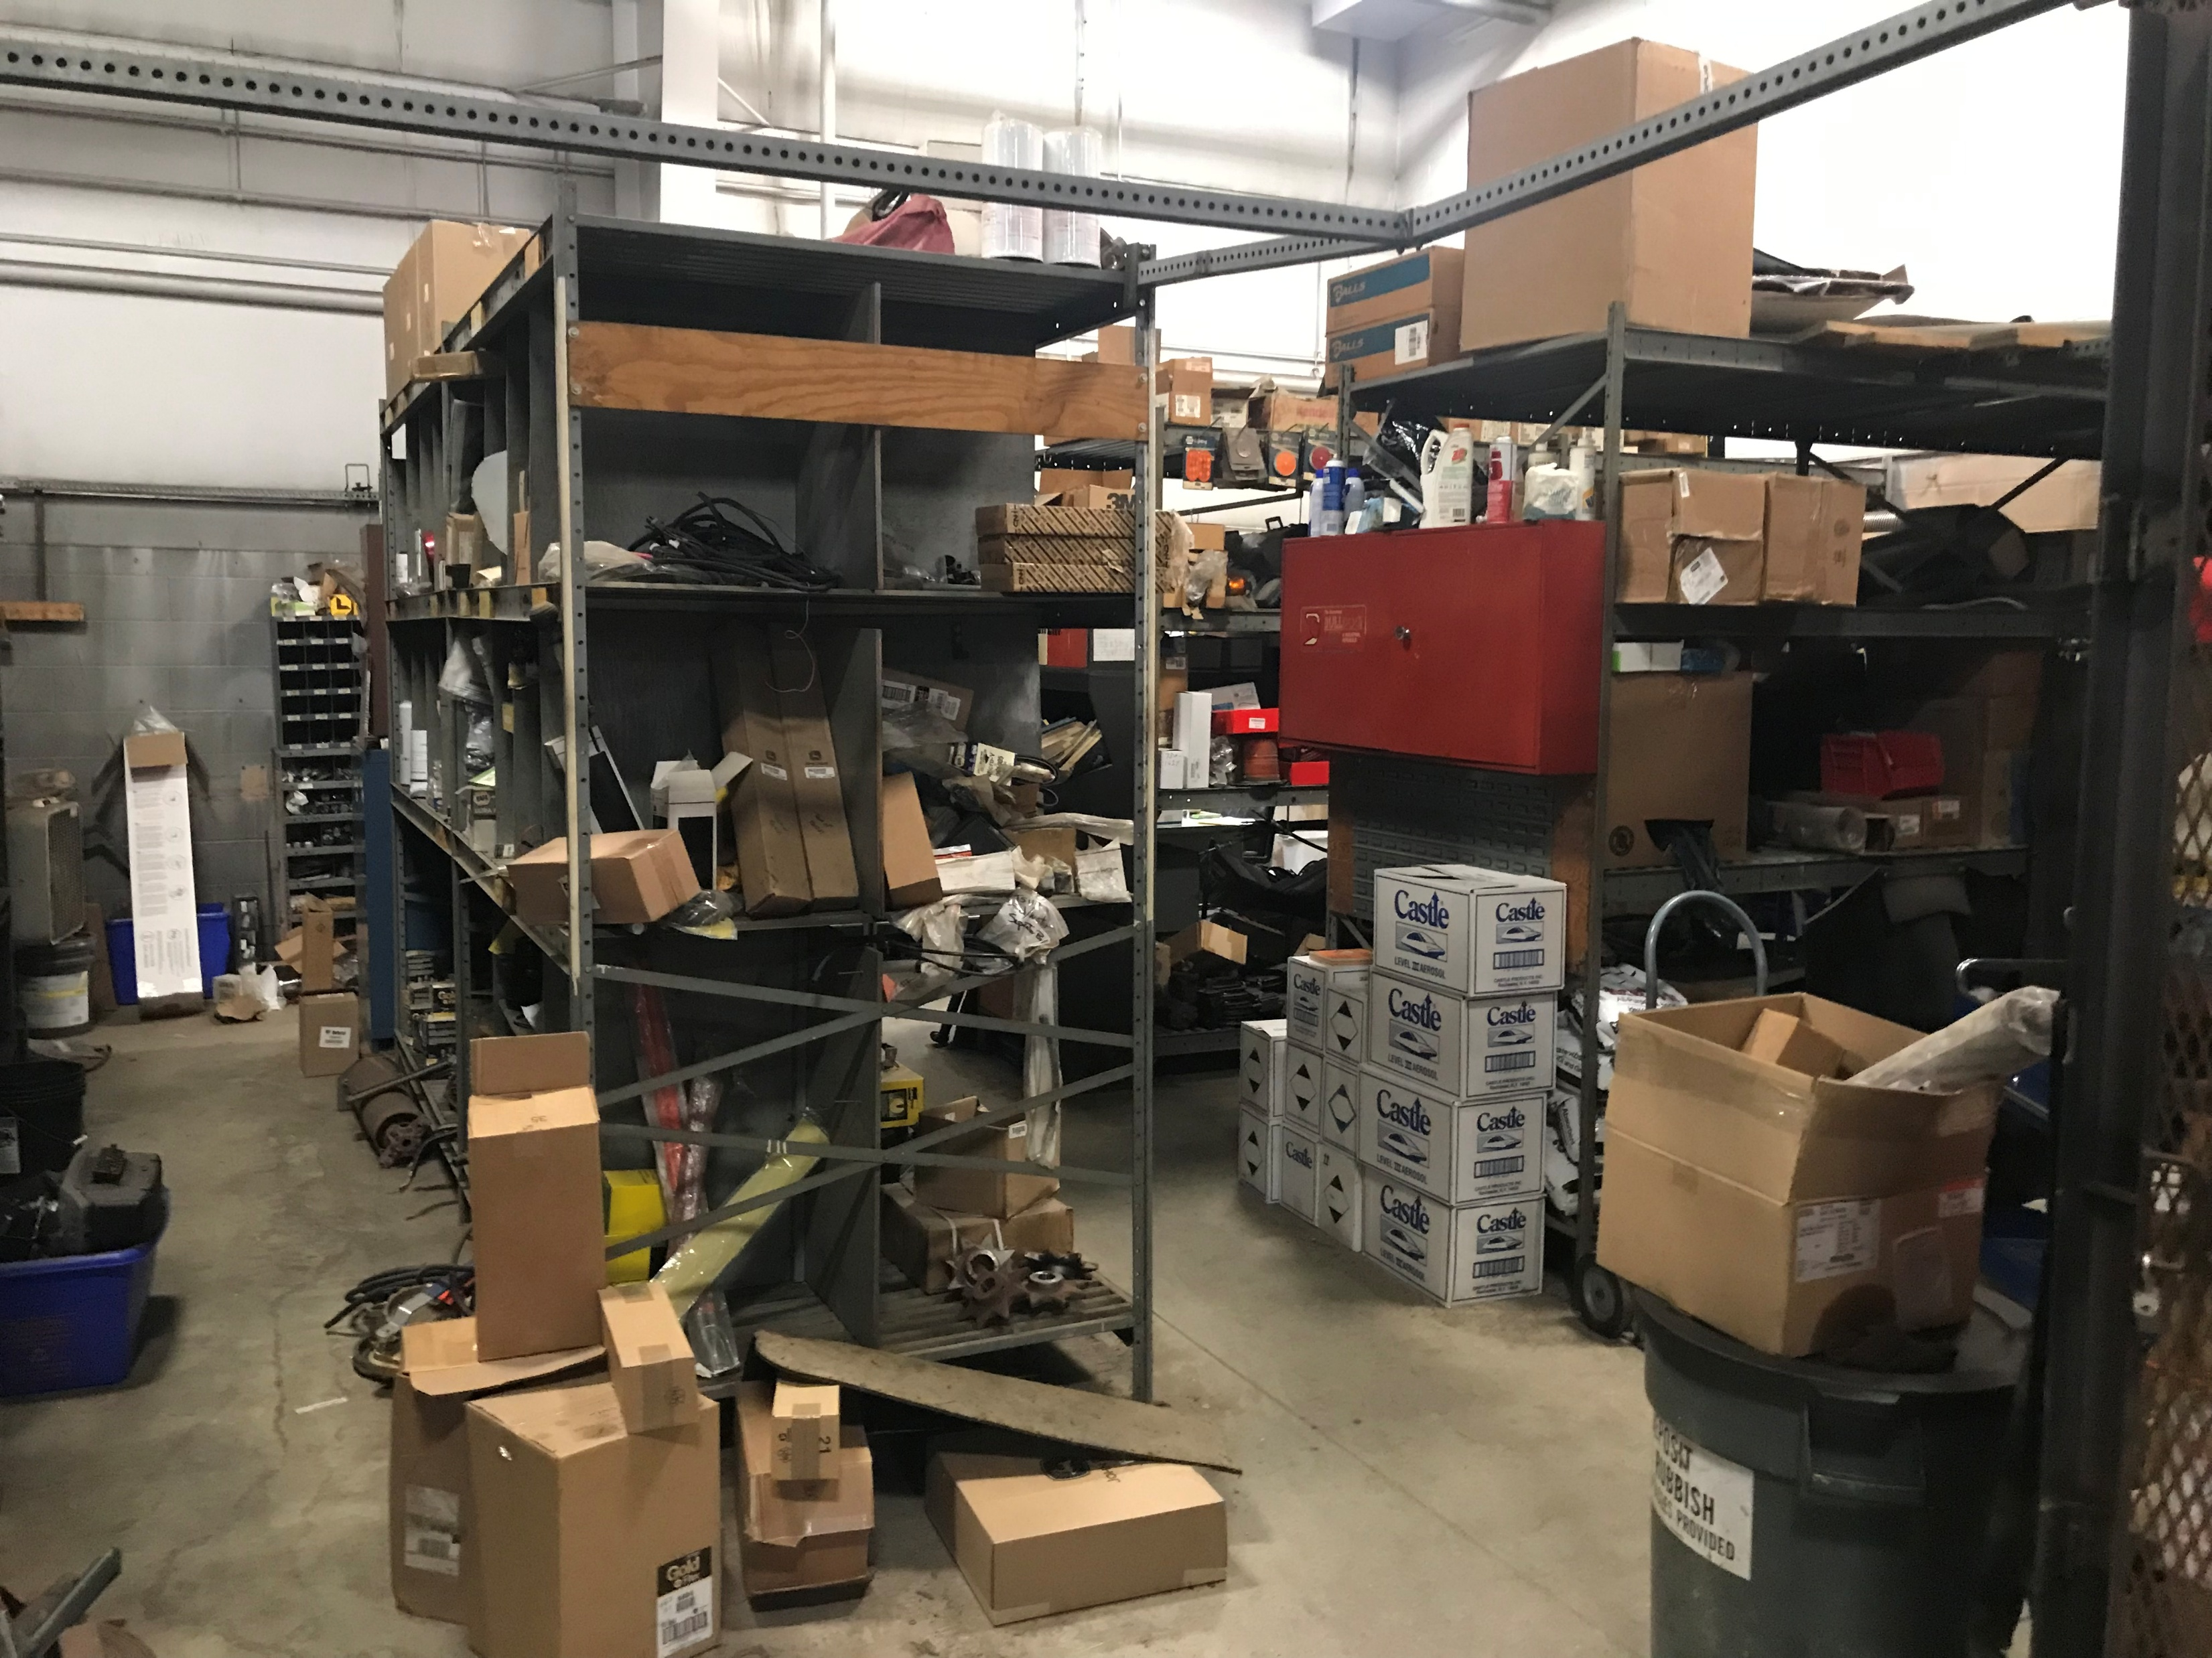
HIGHWAY FACILITIES ENHANCEMENT PROJECT
THE NEED FOR PARTS & MAINTENANCE SPACE
VEHICLE MAINTENANCE TAKES UP AT LEAST 3 BAYS OF THE MAIN GARAGE– SPACE THAT SHOULD BE FOR TRUCKS
THE CURRENT SPACE HAS NO LIFT OR PIT
MECHANICS MUST LAY ON THE COLD CONCRETE SLAB TO WORK UNDER VEHICLES
PARTS TAKES UP 1 ½ BAYS THAT SHOULD BE FOR TRUCKS
BOTH PARTS AND MAINTENANCE ARE EXPOSED TO THE TEMPERATURE VARIATIONS OF THE MAIN GARAGE
LIGHTING IS POOR FOR BOTH PARTS AND MAINTENANCE

Slide 10
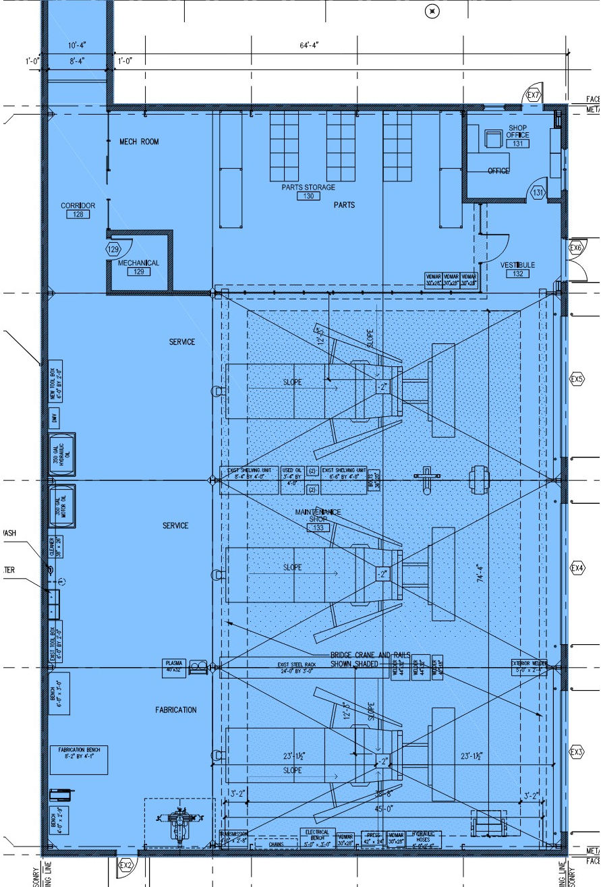
HIGHWAY FACILITIES ENHANCEMENT PROJECT
8,115 SF PARTS & MAINTENANCE ADDITION
3 WIDE BAYS DEDICATED TO VEHICLE MAINTENANCE & FABRICATION
5 TON OVERHEAD BRIDGE CRANE
SEPARATE BUILDING WITH PROPER VENTILATION AND RADIANT SLAB HEAT
1 BAY DEDICATED TO PARTS AND A MAINTENANCE OFFICE
SAME FLOOR LEVEL AS THE EXISTING MAIN GARAGE
NEW, BRIGHT LED LIGHTING
FREES UP 4 ½ BAYS OF THE MAIN GARAGE FOR FUTURE GROWTH

Slide 11
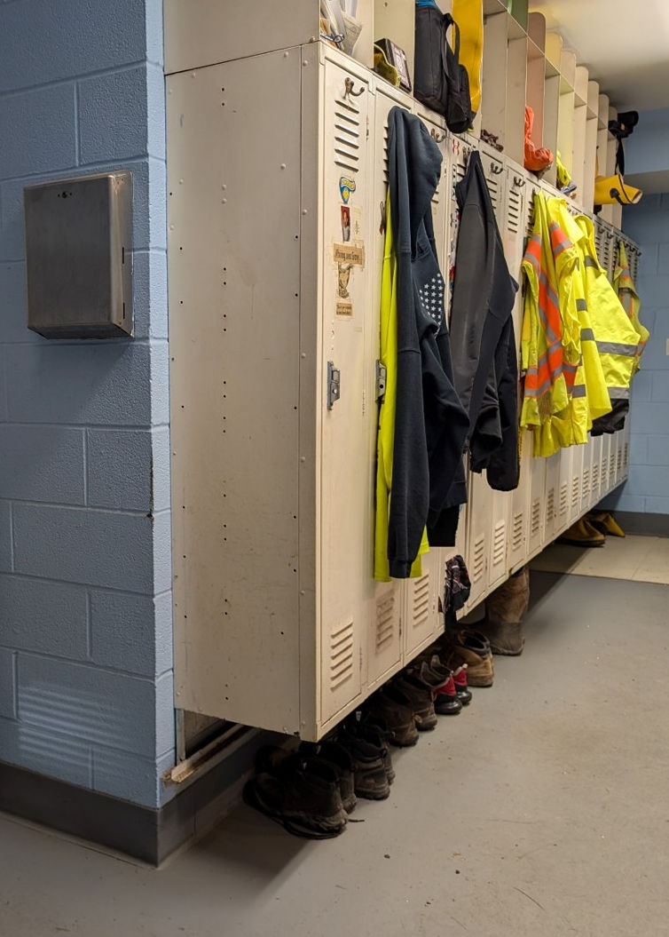
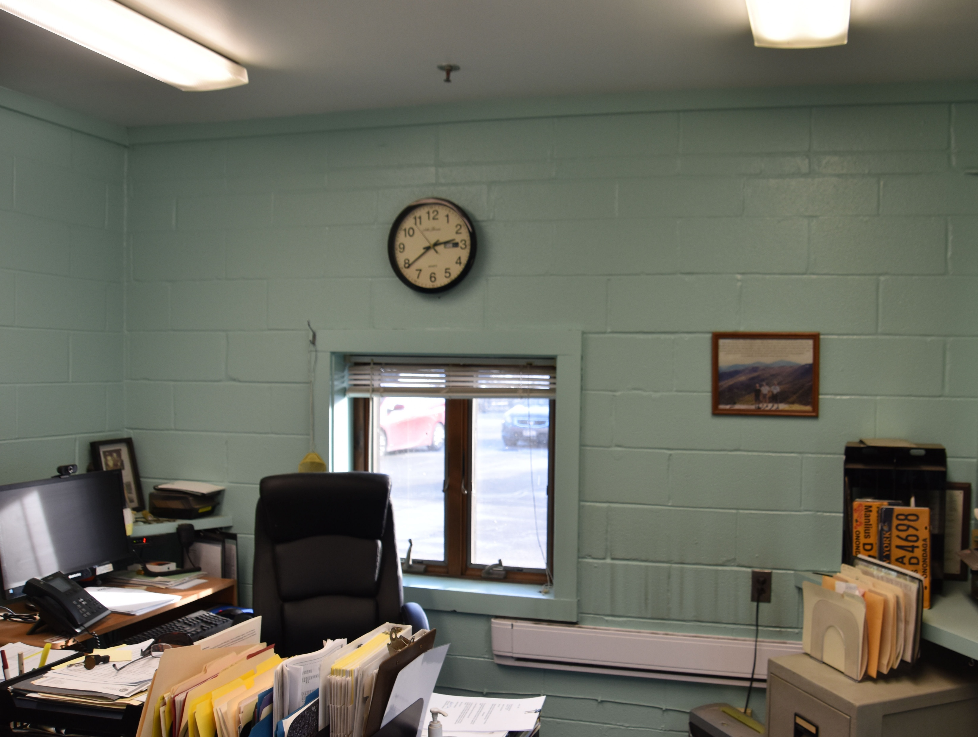
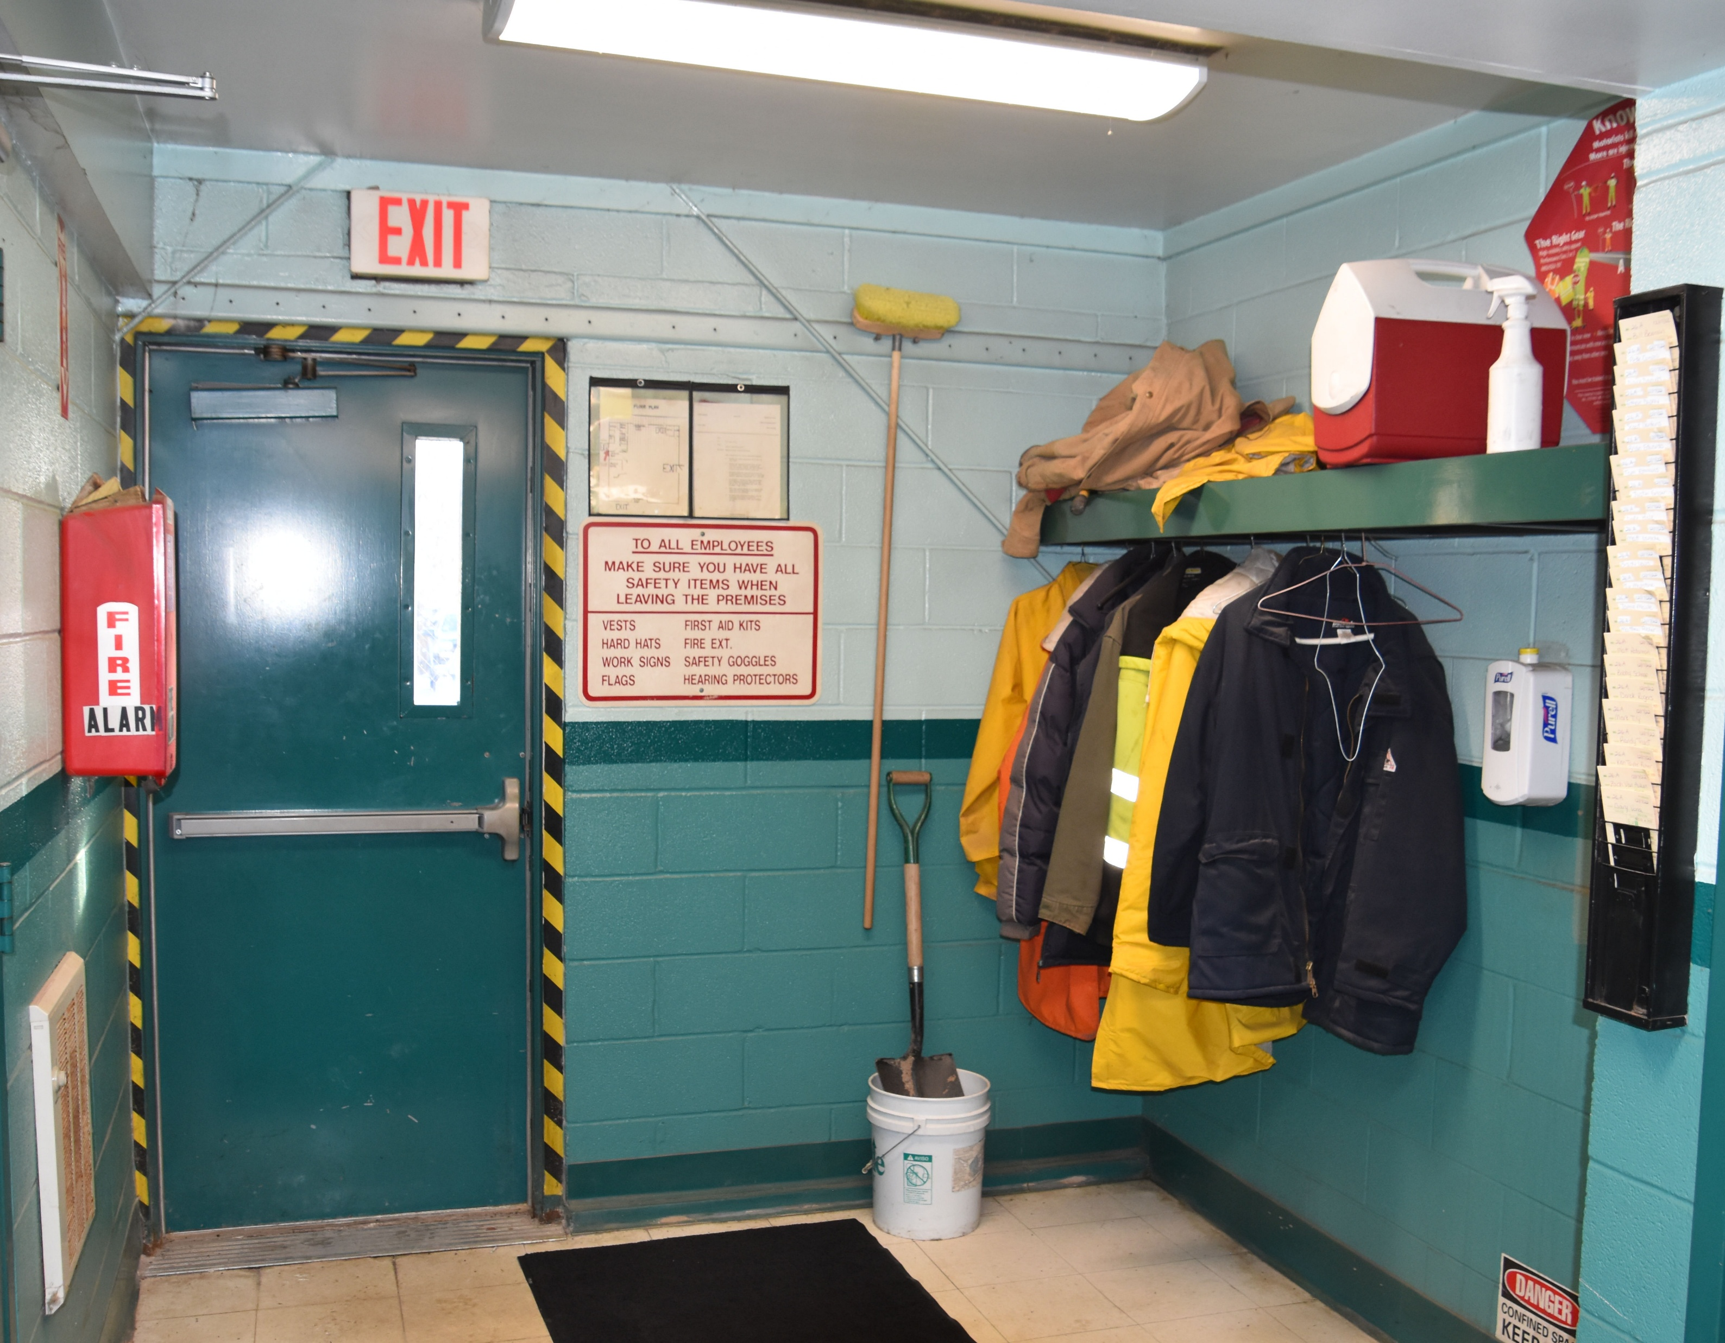
HIGHWAY FACILITIES ENHANCEMENT PROJECT
THE NEED FOR LOCKER ROOMS & OFFICE SPACE
THE MEN’S LOCKER ROOM IS TOO SMALL & PLUMBING IS ANTIQUATED
THERE ARE NO WOMEN’S LOCKER FACILITIES
SUPERINTENDENT’S OFFICE IS TOO SMALL AND IN NEED OF RENOVATION
THE ENTRANCE IS CONFUSING FOR VISITORS AND ALLOWS ACCESS TO THE MAIN GARAGE; THERE IS NO RECEPTION OR WAITING AREA
THERE IS NO MEETING/CONFERENCE ROOM

Slide 12
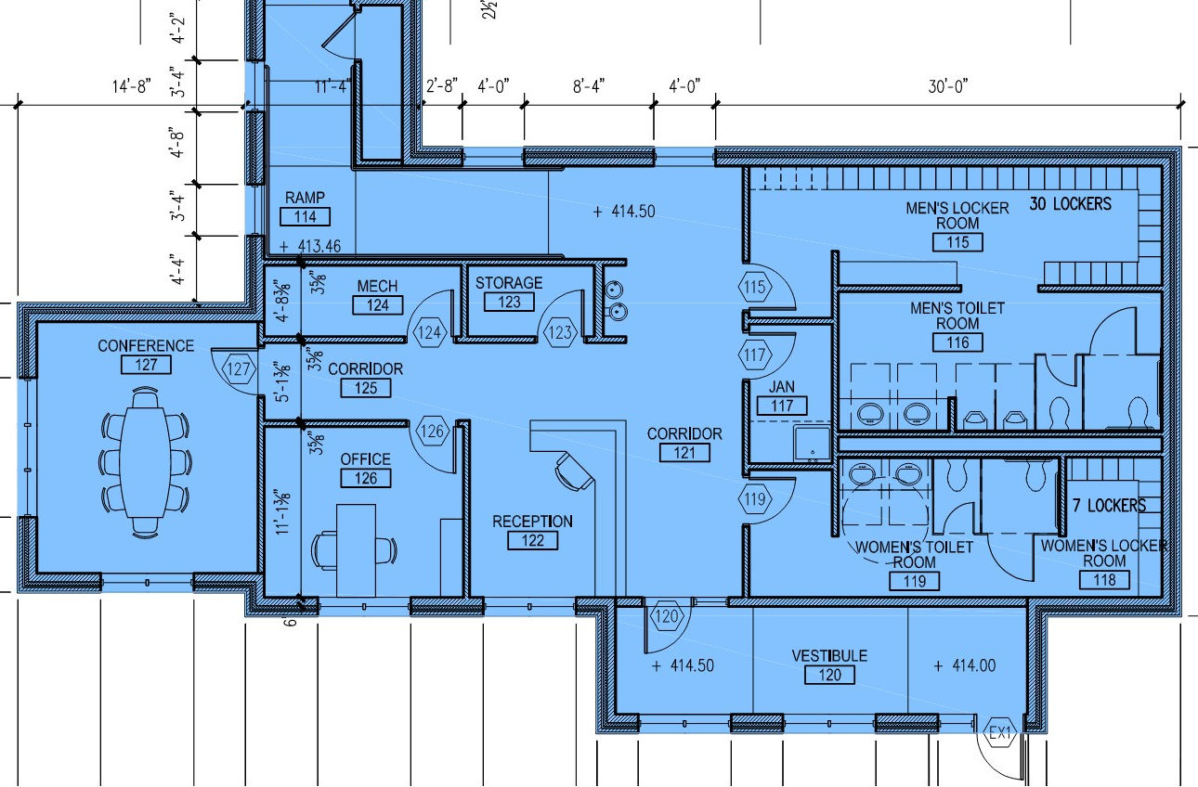
HIGHWAY FACILITIES ENHANCEMENT PROJECT
LOCKER ROOMS & OFFICE ADDITION
MEN’S LOCKER ROOM WITH 30 LOCKERS
WOMEN’S LOCKER ROOM WITH 7 LOCKERS
135 SF SUPERINTENDENT’S OFFICE
220 SF CONFERENCE ROOM
MAIN ENTRANCE WITH RECEPTION AREA FOR HIGHWAY SECRETARY

Slide 13
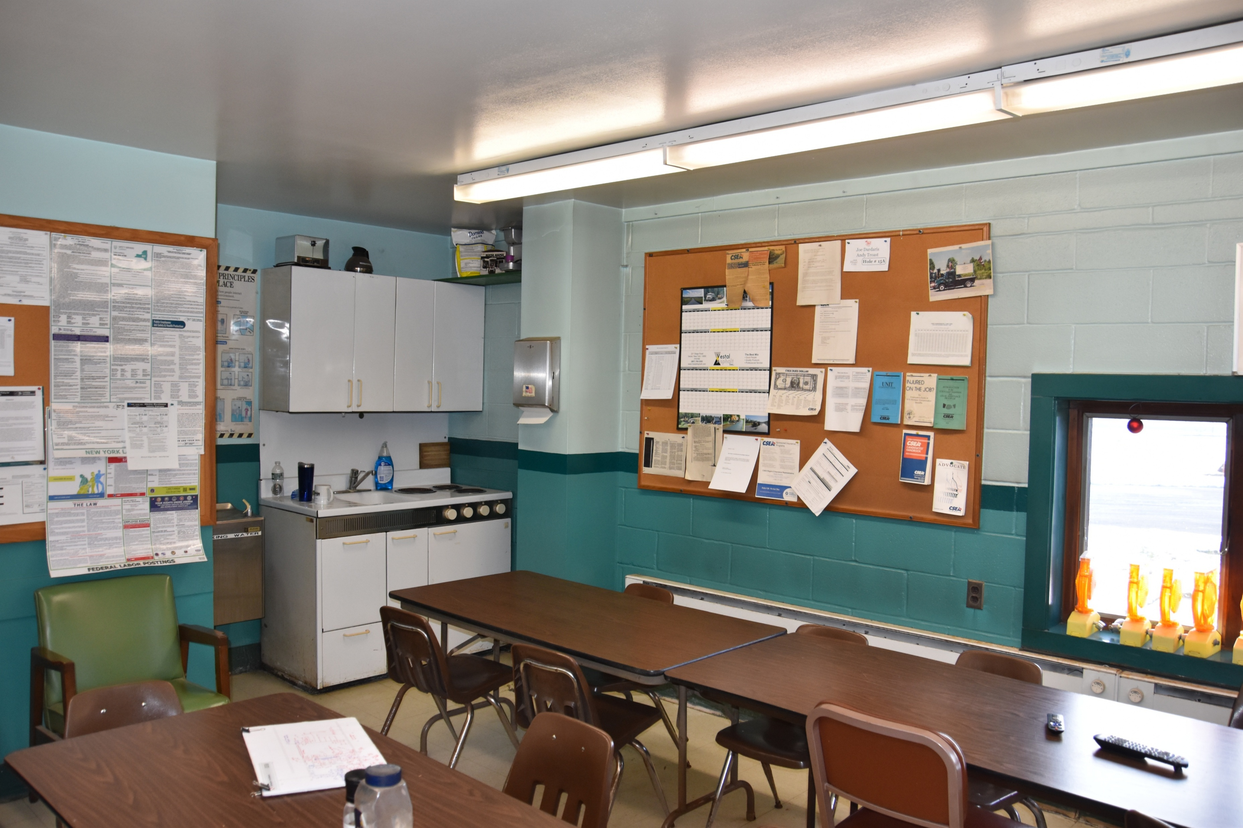
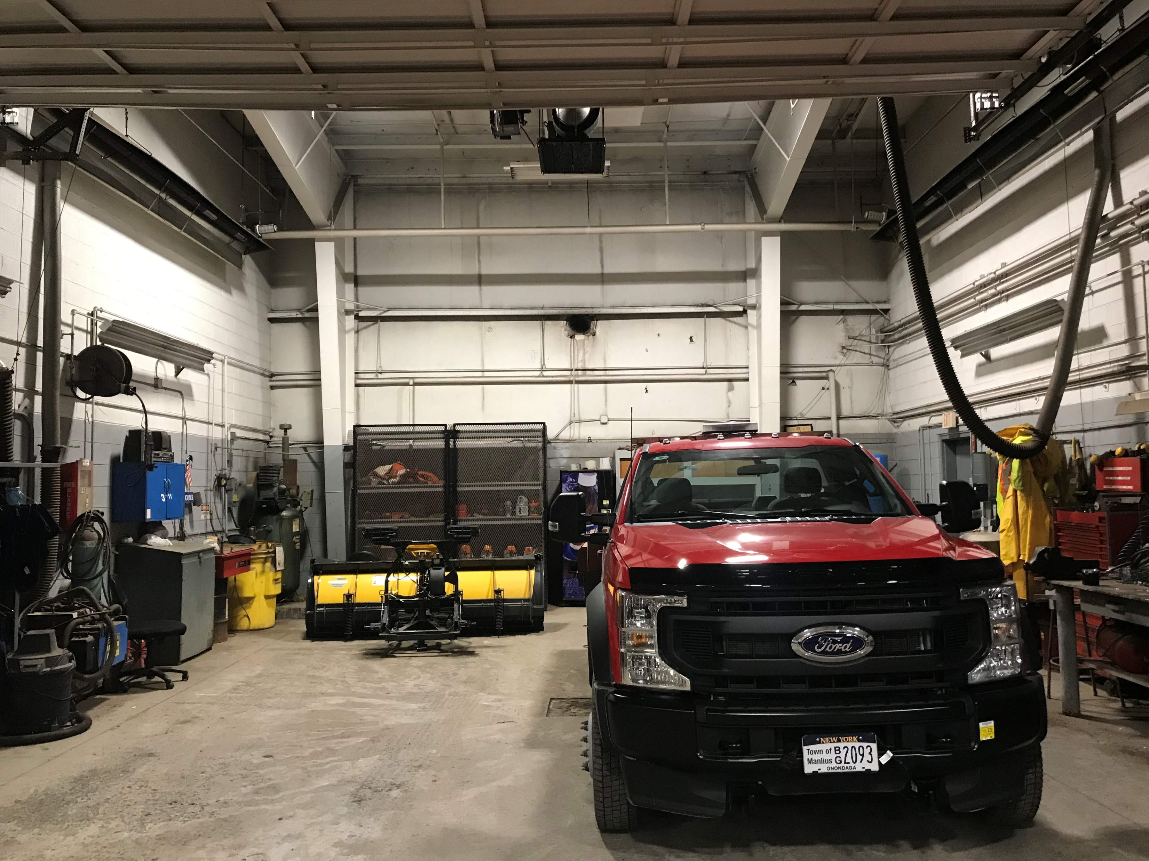
HIGHWAY FACILITIES ENHANCEMENT PROJECT
THE NEED FOR A BREAK ROOM & TRAINING ROOM
THE EXISTING BREAK ROOM IS TOO SMALL
BREAK ROOM CABINETRY & APPLIANCES ARE ANTIQUATED
THE ORIGINAL MAINTENANCE BAY IS USED FOR TRAINING BUT THE SPACE IS ILL-EQUIPED FOR TRAINING
INADEQUATE STORAGE FOR TRAINING, BREAK ROOM, AND OFFICES

Slide 14
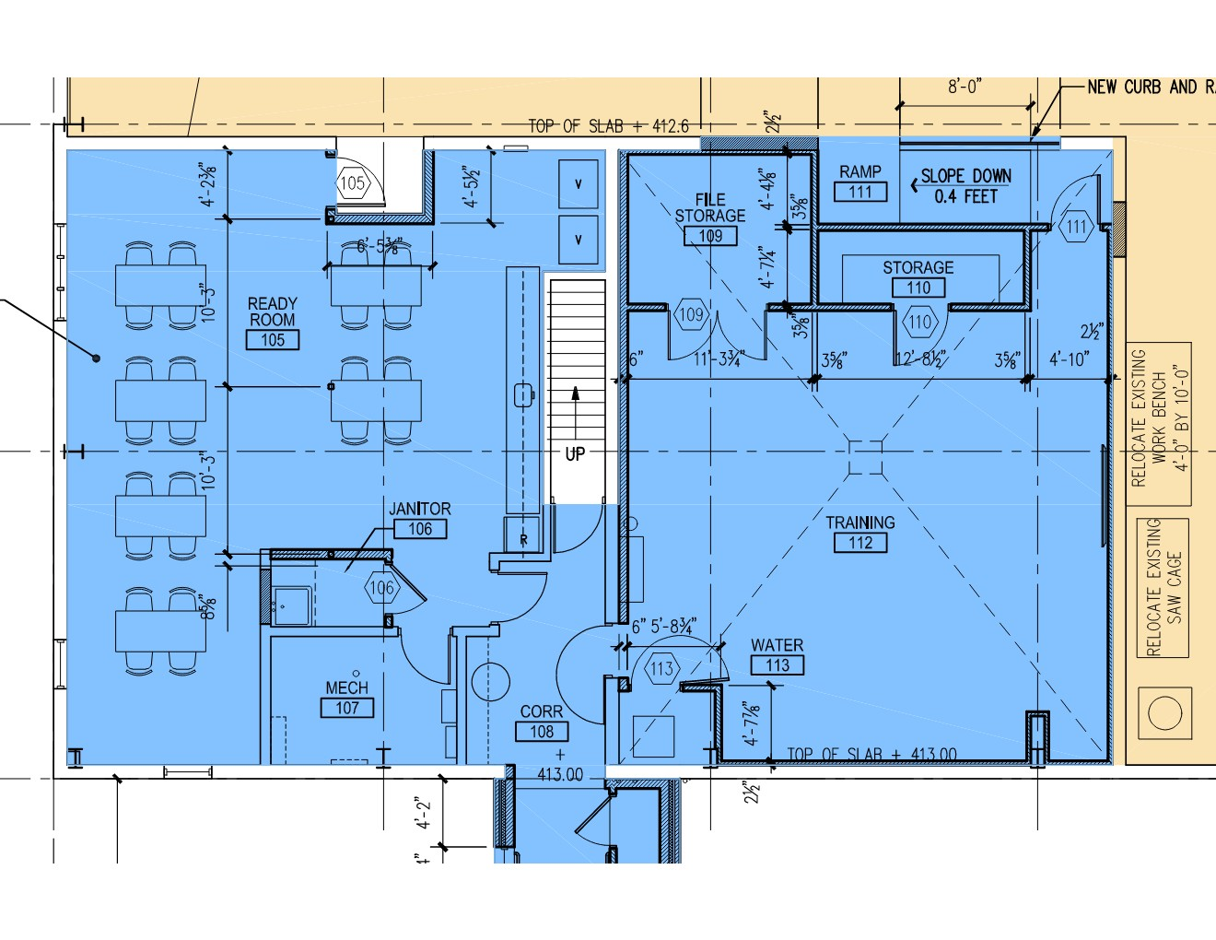
HIGHWAY FACILITIES ENHANCEMENT PROJECT
RENOVATION FOR BREAK ROOM & TRAINING ROOM
DEMOLISH THE OLD LOCKER ROOM & OFFICE; CONSTRUCT A LARGER BREAK ROOM
PROVIDE NEW BREAK ROOM CABINETRY AND APPLIANCES
RENOVATE THE OLD MAINTENANCE SPACE AND CONSTRUCT SECURE STORAGE

Slide 15
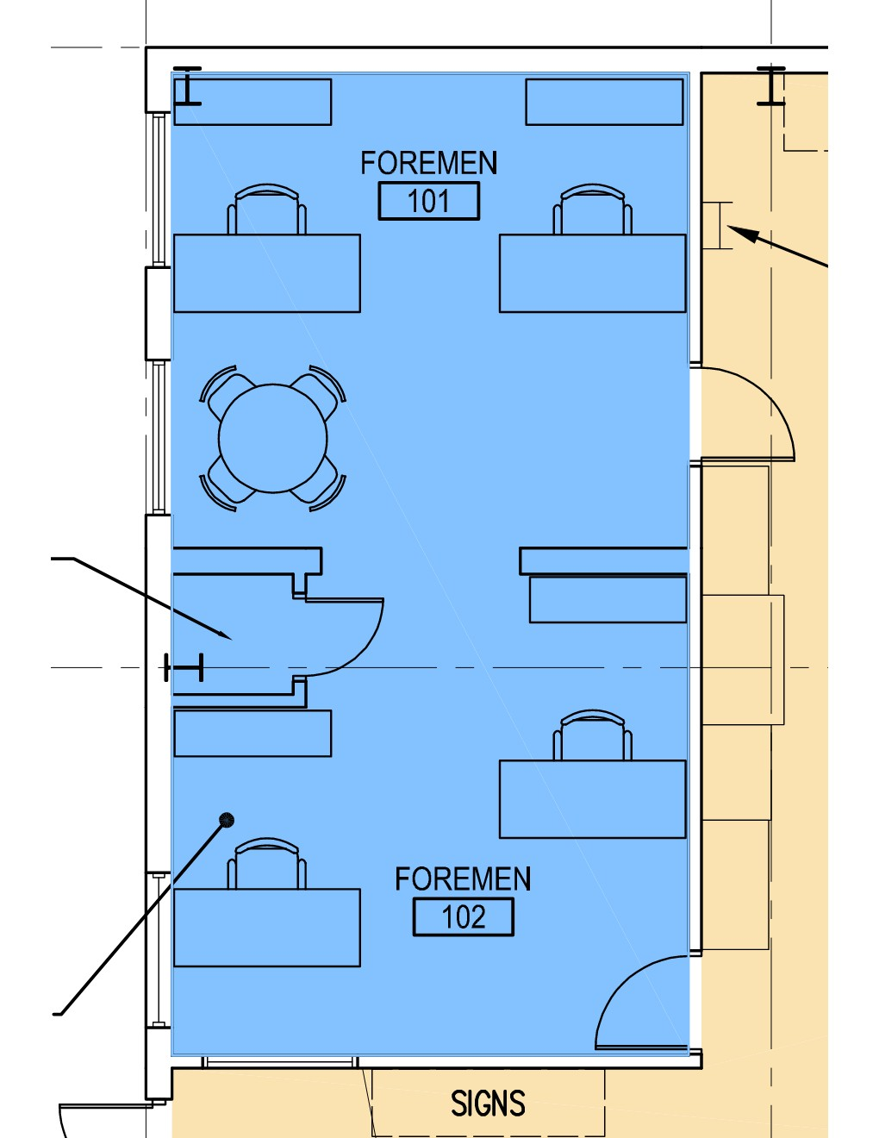
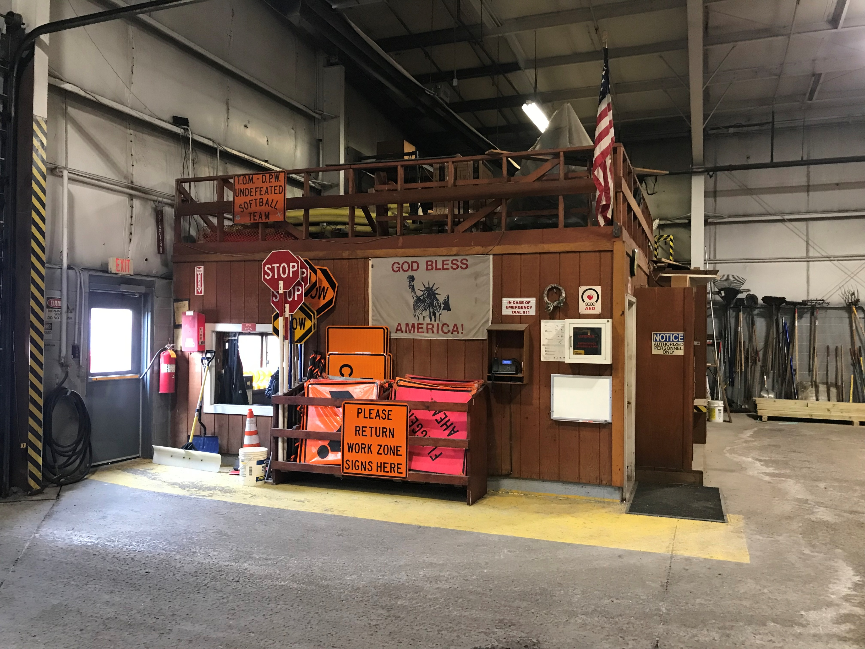
HIGHWAY FACILITIES ENHANCEMENT PROJECT
THE FOREMEN’S OFFICE
THE EXISTING OFFICE IS TOO SMALL
THE OFFICE CURRENTLY INCLUDES THE HIGHWAY SECRETARY, WHO WILL MOVE TO THE ADDITION
BY UTILIZING THE OLD VAULT, THE OFFICE SIZE WILL BE DOUBLED, PROVIDING ADEQUATE WORK SPACE AND IMPROVED PRIVACY

Slide 16
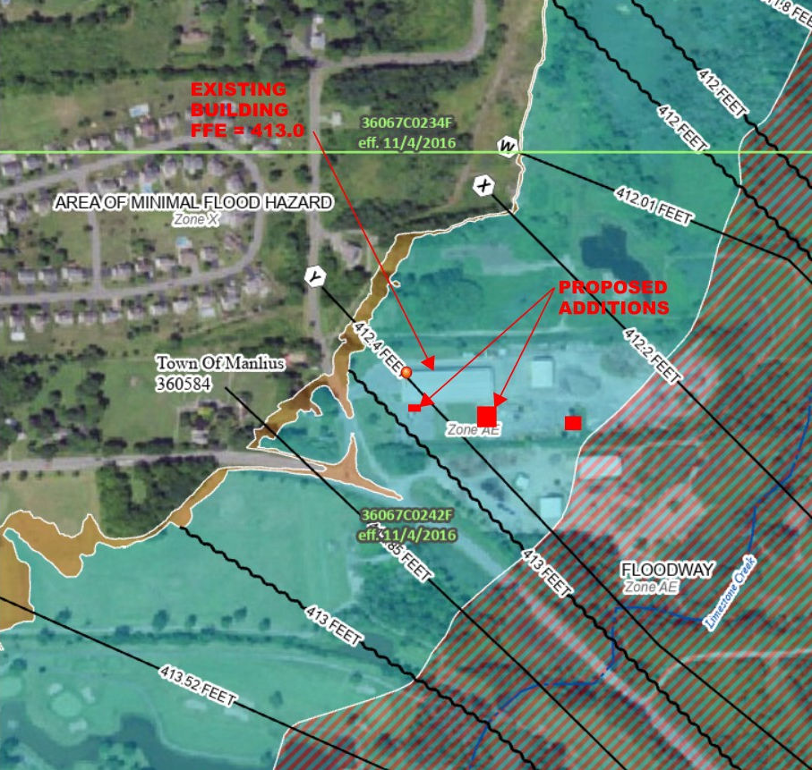
HIGHWAY FACILITIES ENHANCEMENT PROJECT
FLOOD MITIGATION CHALLENGES
LIMESTONE CREEK IS AT THE EASTERN END OF THE PROPERTY
THE PROPERTY IS LOCATED IN A SPECIAL FLOOD HAZARD AREA (SFHA)
THIS PROPERTY HAS A BASE FLOOD ELEVATION (BFE) OF 412.5. THE EXISTING MAIN GARAGE HAS A FLOOR ELEVATION OF 413.0 (6” ABOVE BFE)
FEMA AND THE STATE DEC REQUIRES MOST NON-RESIDENTIAL BUILDINGS IN A SFHA TO EITHER HAVE WET FLOODPROOFING OR DRY FLOODPROOFING

Slide 17
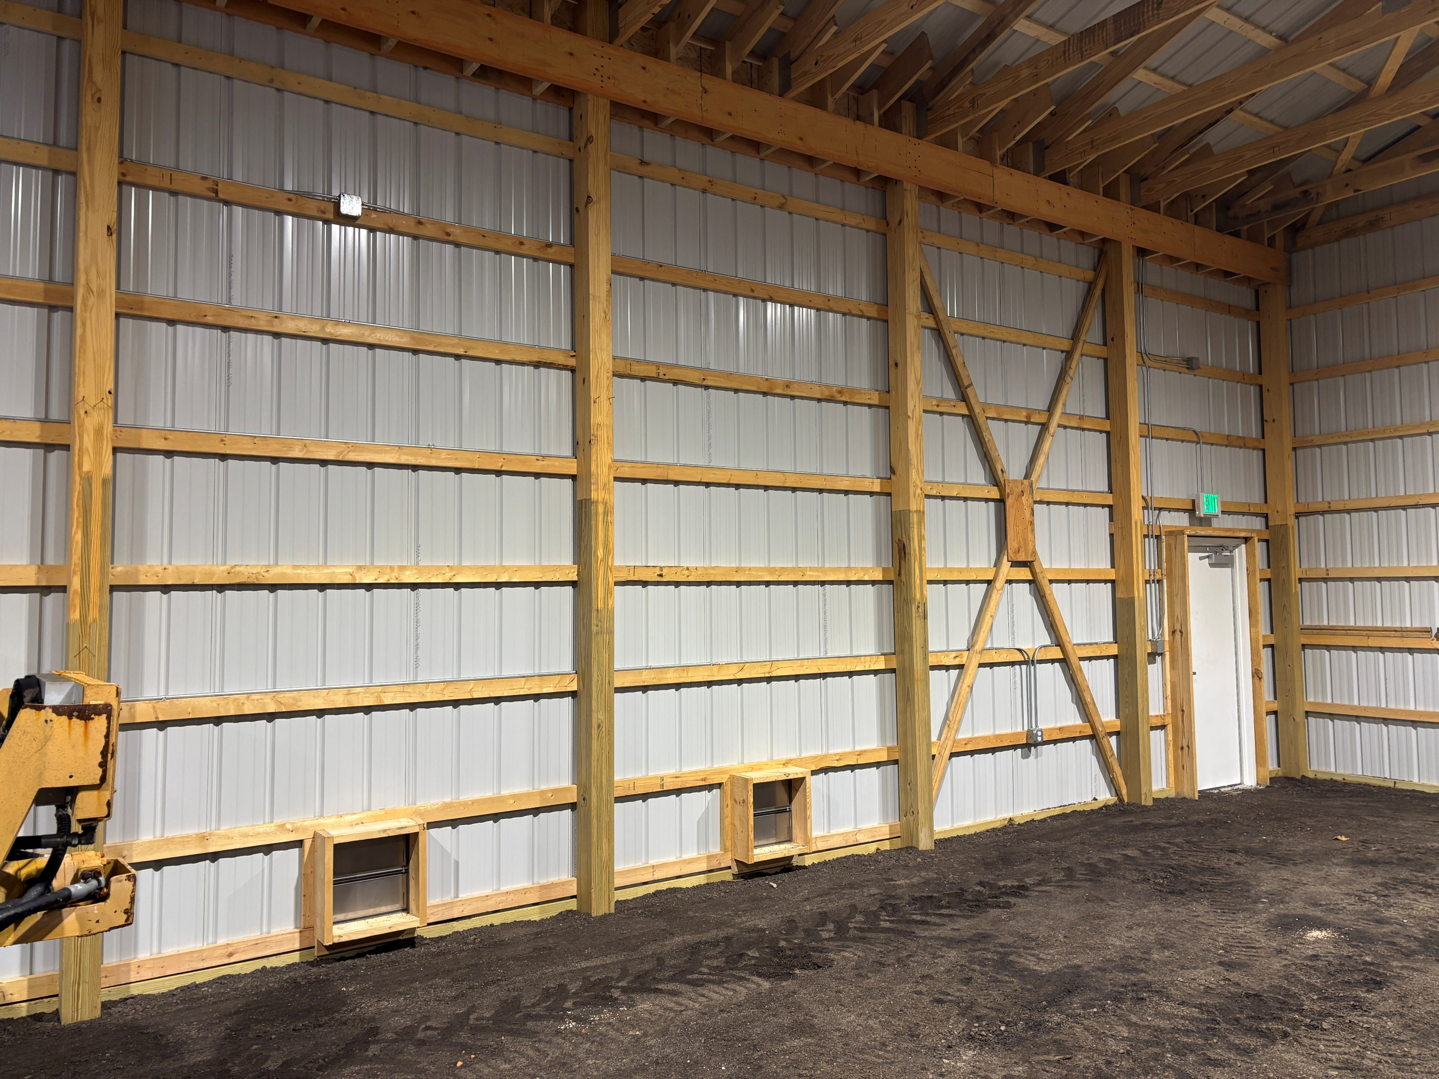
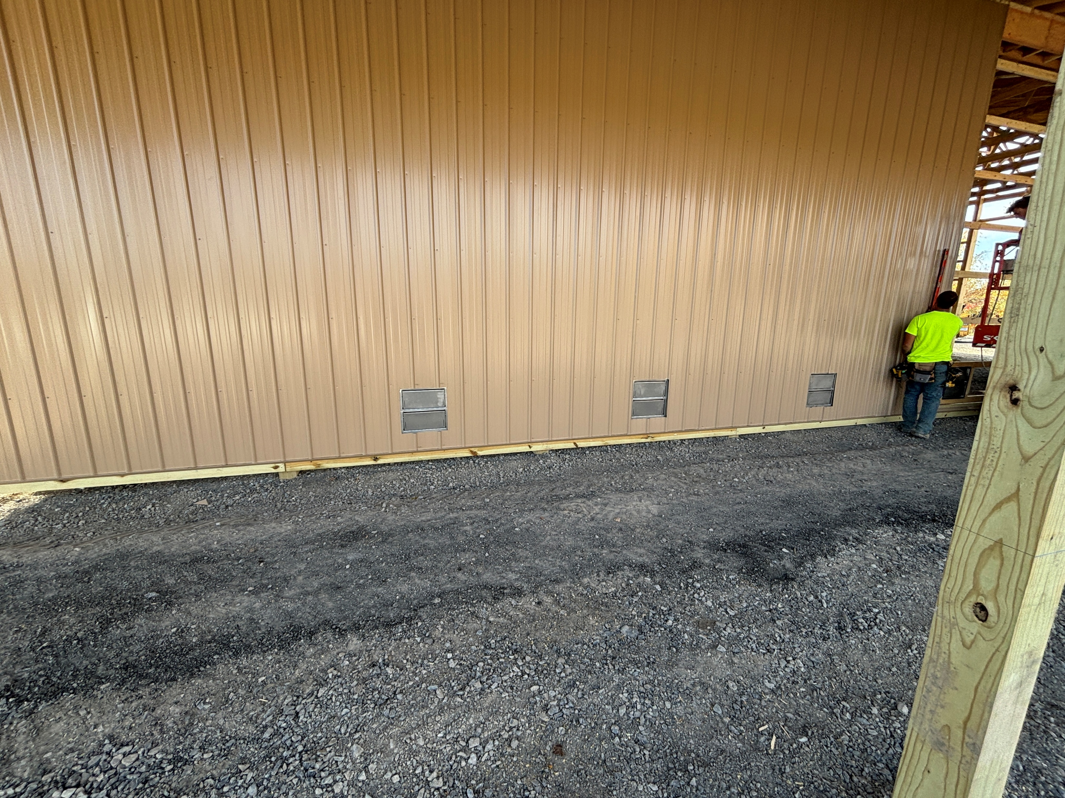
HIGHWAY FACILITIES ENHANCEMENT PROJECT
FLOOD MITIGATION SOLUTIONS
AT THE VEHICLE STORAGE BUILDING, WE OPTED TO SET THE FLOOR ELEVATION AT 412.5 AND PROVIDE METAL WALLS. THIS ALLOWED US TO UTILIZE WET FLOODPROOFING VIA 12 SMALL FLOOD VENTS IN THE SIDE WALLS

Slide 18
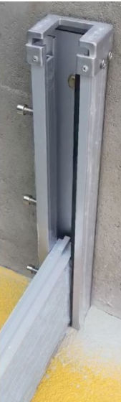
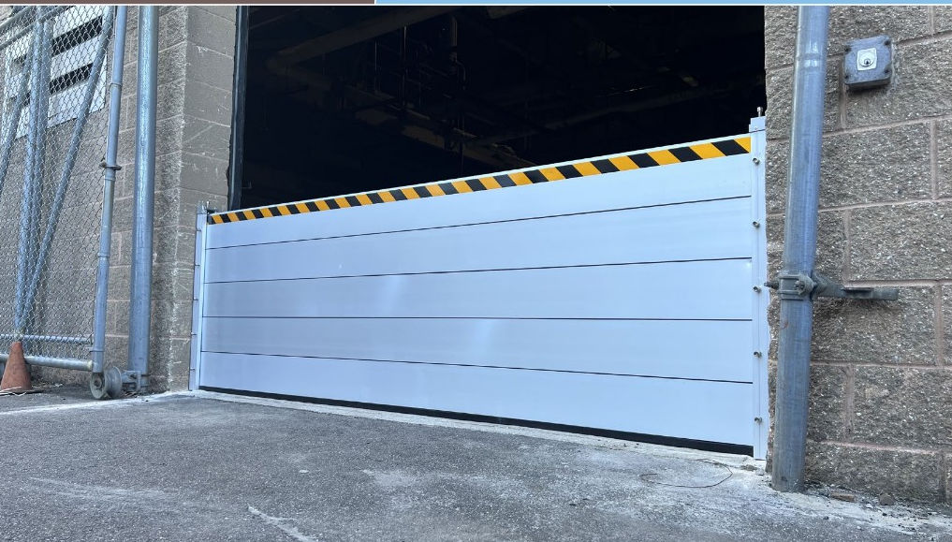
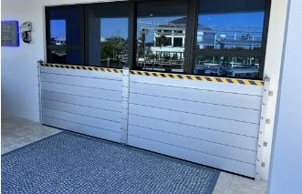
HIGHWAY FACILITIES ENHANCEMENT PROJECT
FLOOD MITIGATION SOLUTIONS
AT THE MAINTENANCE ADDITION, WE OPTED TO SET THE FLOOR ELEVATION AT 413.0 (FOR EASE OF TRAVEL BETWEEN THE ADDITION AND THE MAIN GARAGE), RAISE ALL ELECTRICAL TO AT LEAST 2’ ABOVE THE FLOOR, AND PROVIDE REINFORCED MASONRY WALLS TO 8’ HIGH. THIS ALLOWED US TO UTILIZE WET FLOODPROOFING VIA A TEMPORARY, 2’ HIGH, ALUMINUM FLOOD BARRIER SYSTEM AT THE 7 PERIMETER DOORS

Slide 19
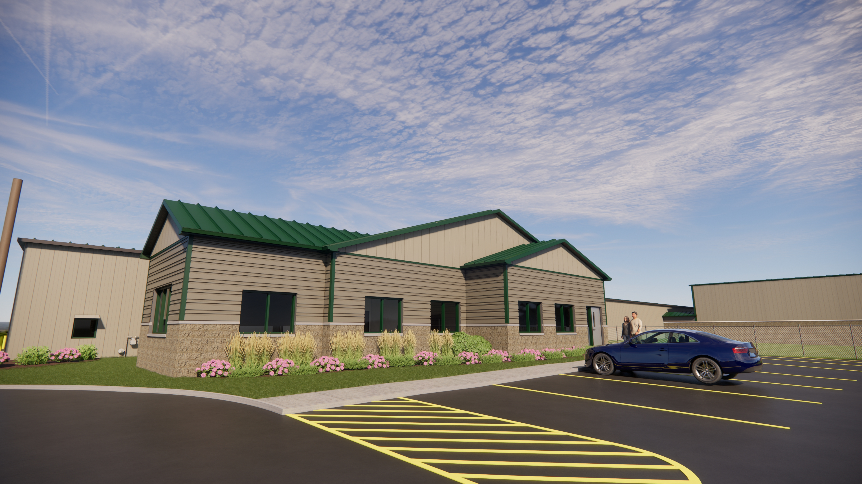
HIGHWAY FACILITIES ENHANCEMENT PROJECT
FLOOD MITIGATION SOLUTIONS
AT THE OFFICE/LOCKER ROOM ADDITION, WE OPTED TO SET THE FLOOR ELEVATION AT 414.5 (2’ ABOVE THE BASE FLOOD ELEVATION). THIS IS CONSIDERED DRY FLOODPROOFING, AN APPROACH THAT PROTECTS THE DRYWALL, INSULATION, AND FLOORING MATERIALS THAT WOULD REQUIRE REPLACEMENT IF THEY BECAME SATURATED

Slide 20
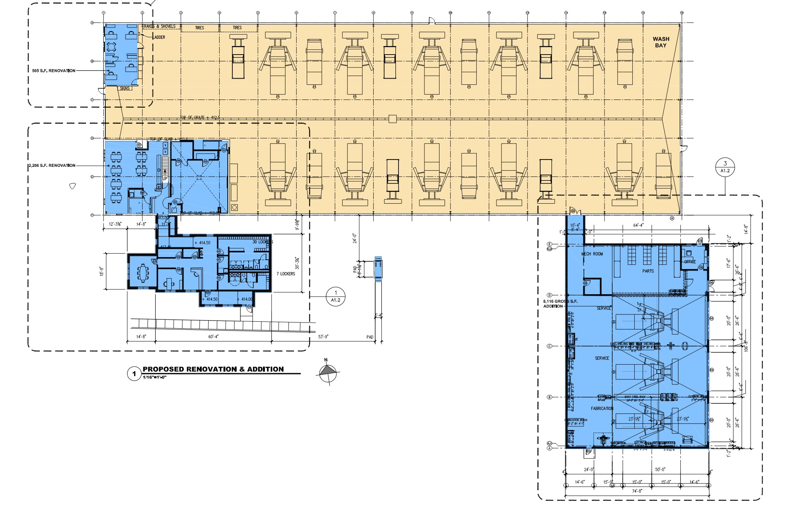
HIGHWAY FACILITIES ENHANCEMENT PROJECT
BUILDING FUNCTIONALITY
THE ADDITIONS & RENOVATIONS WILL BE FULLY ACCESSIBLE, WELL-INSULATED AND ENERGY-EFFICIENT
PARTS & MAINTENANCE WILL HAVE NEW, DEDICATED SPACE
OFFICES, BREAK ROOM, TRAINING ROOM, & LOCKER ROOMS WILL BE LARGE ENOUGH, & HAVE APPROPRIATE FINISHES/AMENITIES
ALL FACILITIES WILL BE BACKED-UP BY A NEW GENERATOR

Slide 21
HIGHWAY FACILITIES ENHANCEMENT PROJECT
BUILDING APPEARANCE
NEW METAL SIDING AND DECORATIVE MASONRY HAVE BEEN SELECTED TO BLEND WITH AND COMPLIMENT THE EXISTING MAIN GARAGE AND VEHICLE STORAGE BUILDING TAN SIDING
NEW METAL ROOFING AND WINDOWS HAVE BEEN SELECTED TO MATCH THE VEHICLE STORAGE BUILDING GREEN ROOF
INTERIOR & EXTERIOR MATERIALS ARE COST-EFFECTIVE YET DURABLE
LANDSCAPING AND RAIN GARDEN COMPLIMENT THE OFFICE/LOCKER ROOM ADDITION

Slide 22
HIGHWAY FACILITIES ENHANCEMENT PROJECT
BID TABULATION FORM
TRADE | CONTRACTOR | NUMBER OF BIDDERS | CONTRACT AMOUNT
SITEWORK | LINDSLEY EXCAVATING | 5 | $583,404
GENERAL CONSTRUCTION | UPSTATE COMPANIES I | 3 | $2,492,000
FIRE PROTECTION | R H FIRE | 1 | $162,000
PLUMBING | POSTLER & JAECKLE | 2 | $229,875
HVAC | AIRSIDE TECHNOLOGY | 2 | $548,900
ELECTRICAL | FISK ELECTRIC | 6 | $351,800
TOTALS |  |  | $4,367,979

Slide 23
HIGHWAY FACILITIES ENHANCEMENT PROJECT
PRELIMINARY CONSTRUCTION SCHEDULE
START SITEWORK | APRIL 21, 2025
START FOUNDATIONS FOR ADDITIONS | MAY 15, 2025
START SUPERSTRUCTURE FOR ADDITIONS | JULY 1, 2025
COMPLETE SUPERSTRUCTURE/START BUILD-OUT | AUGUST 15, 2025
COMPLETE ADDITIONS/ START RENOVATIONS | OCTOBER 15, 2025
COMPLETE SITEWORK | NOVEMBER 1, 2025
COMPLETE RENOVATION WORK | NOVEMBER 15, 2025
COMPLETE PUNCHLIST/ COMMISSIONING/ FULL OCCUPANCY | JANUARY 15, 2026

Slide 24
HIGHWAY FACILITIES ENHANCEMENT PROJECT
4-23-2025

